Slide 1
Deep Learning (CS 898-BD)
Fall 2023
Dr. Shruti Kshirsagar

Slide 2
Contents:Recap of last class
What is CNN? Introduction
Why convnet over feedforward NN
CNN layers
Convolution layer and pooling layer
Fully connected layer
Designing a CNN and how CNN works?
Applications
Advantages of CNN
Limitation of CNN

Slide 3
Contents:Recap of last class
Local connectivity
Parameter sharing
Discrete Convolution
Pooling and subsampling
Generating additional example-Data Augmentation
Imagenet, Resnet, VGGnet-Transfer learning
Batch Normalization
Loss function

Slide 4
Contents:
What is RNN?
Types of architectures
RNN update state equation
Unrolled RNN
Computational graphs
Language modelling example-Character level
Language modelling example-Sentence level
Backpropagation through time-BPTT
Truncated BPTT
RNN tradeoffs

Slide 5
Contents:
Image Captioning
Visual Question Answering
Gradient flows in RNN
Long Short term memory (LSTM)
Gated Recurrent Units (GRU)
Summary

Slide 6
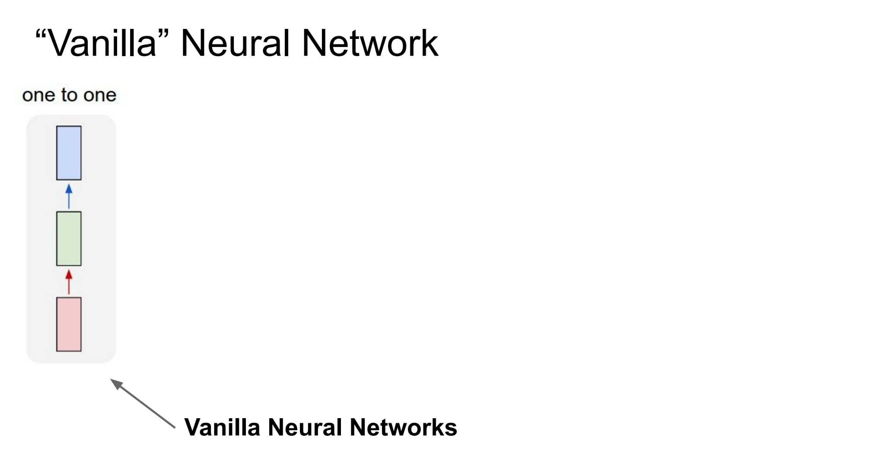
Vanilla Neural Network

Slide 7
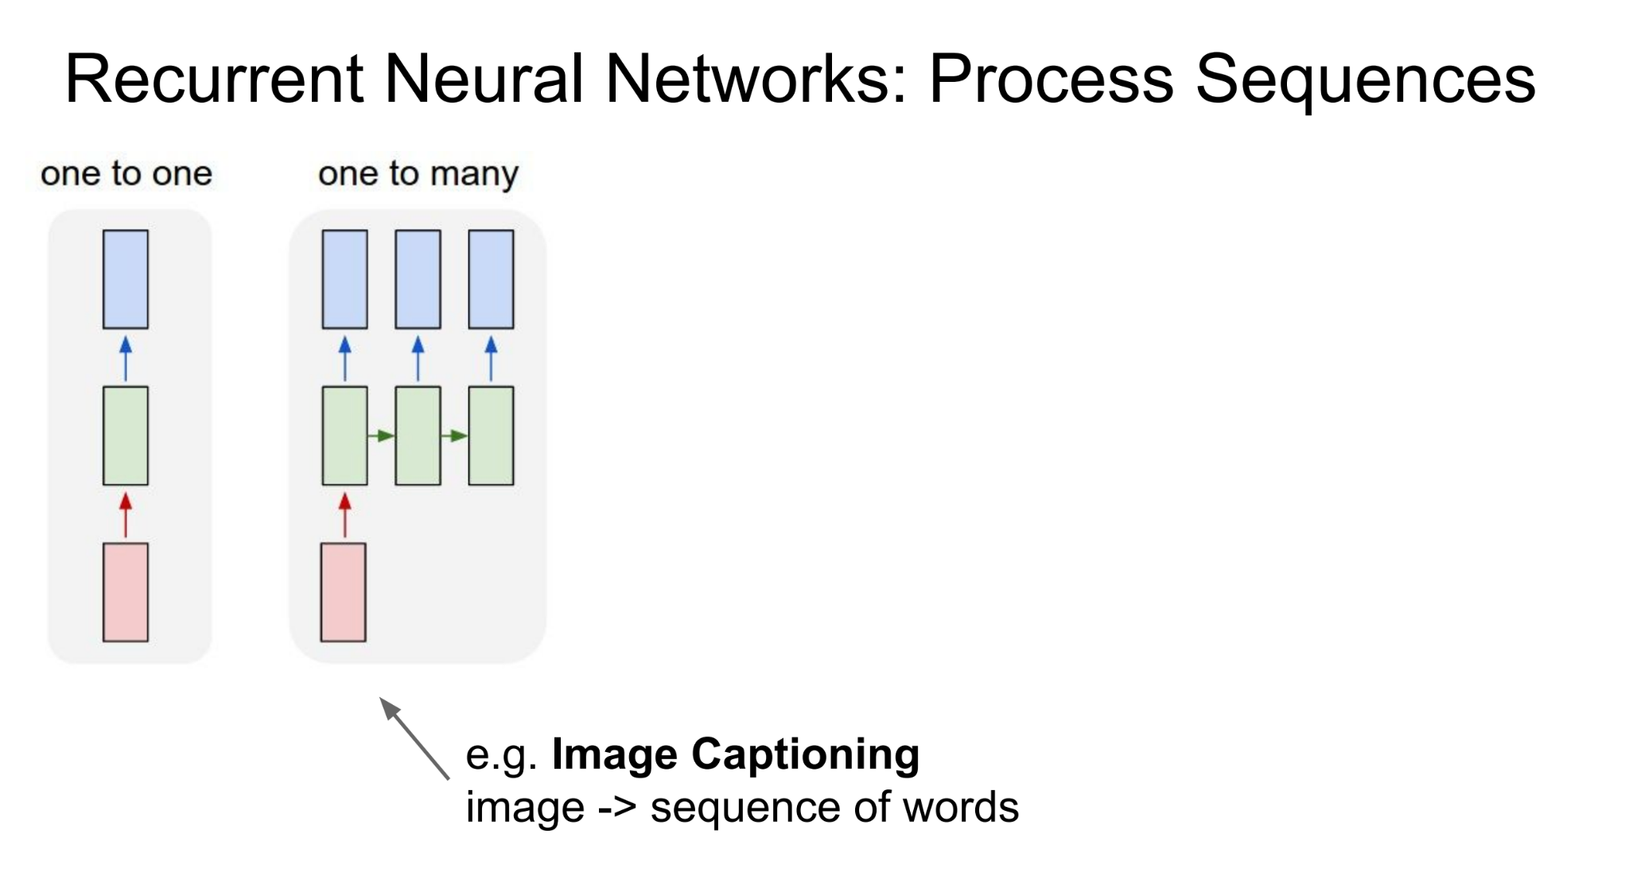
Recurrent Neural Network

Slide 8
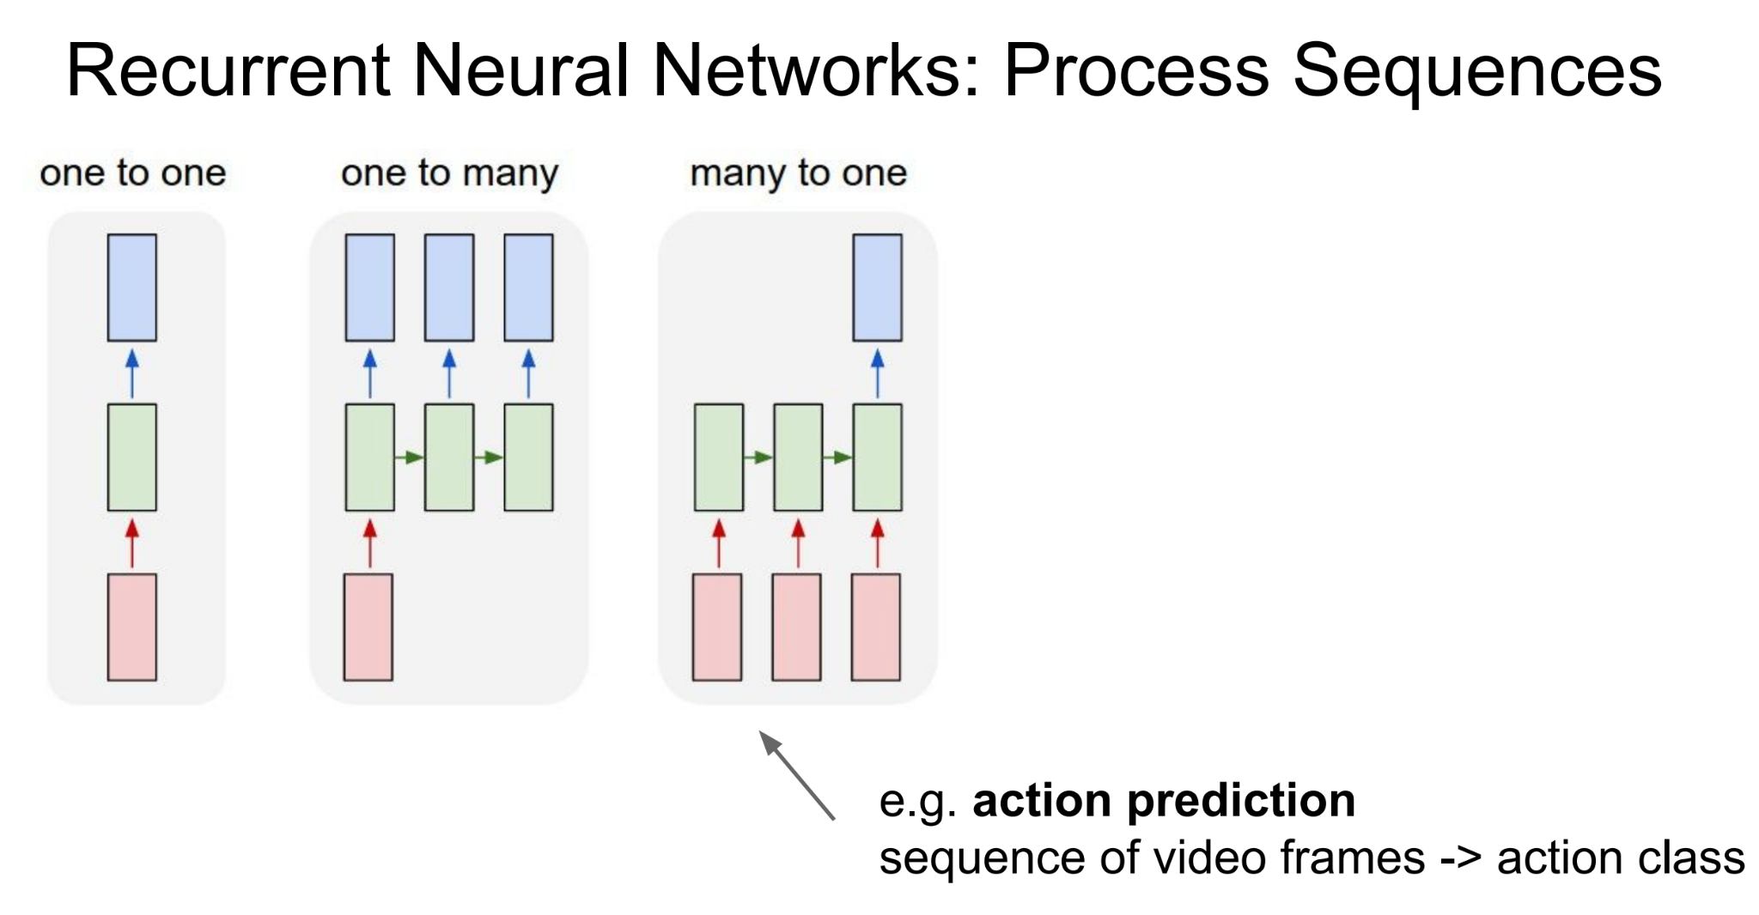
Recurrent Neural Network

Slide 9
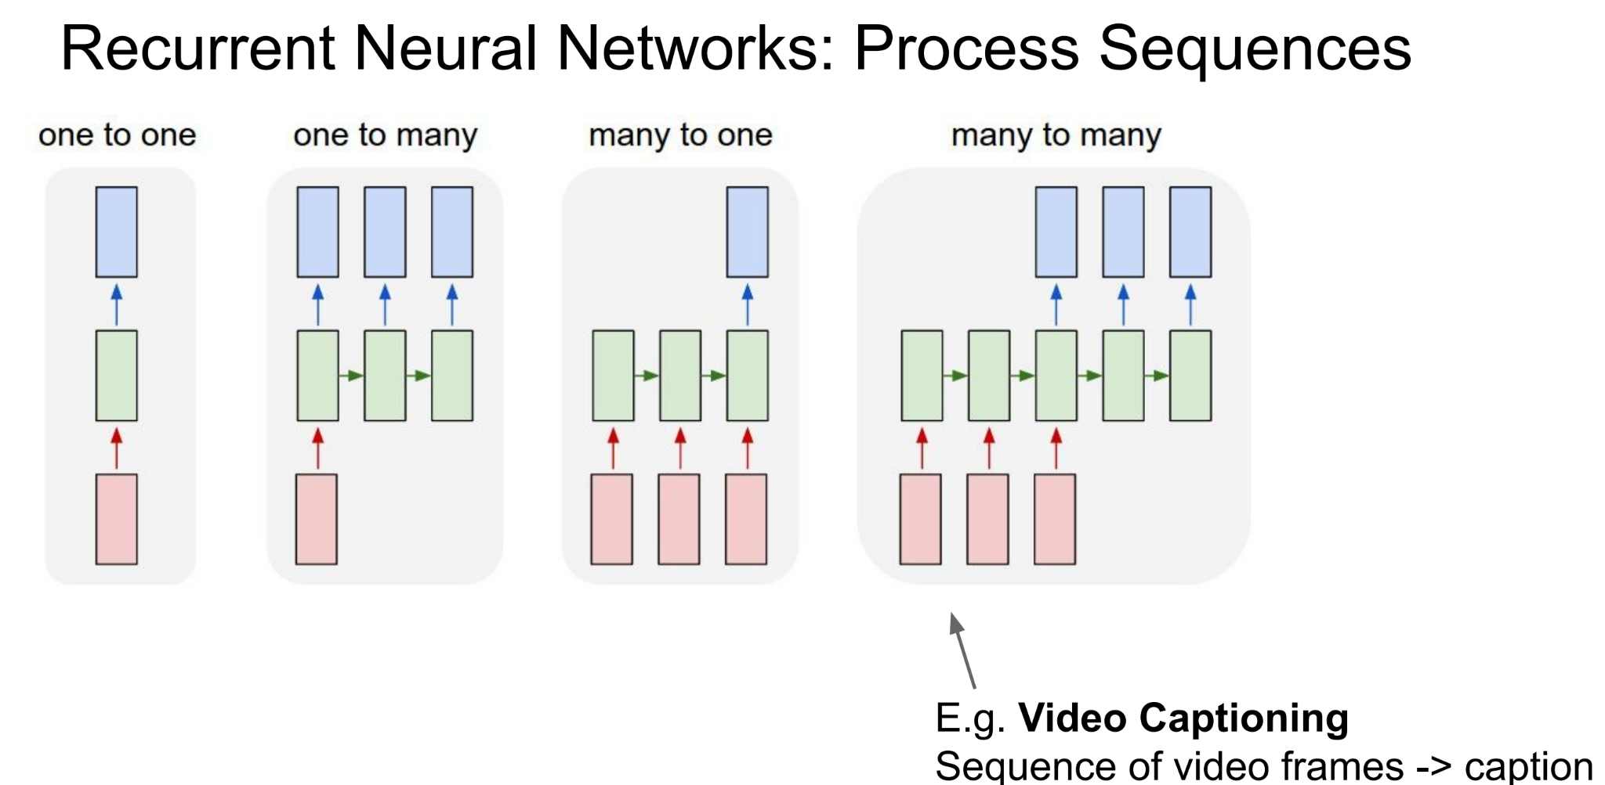
Recurrent Neural Network

Slide 10
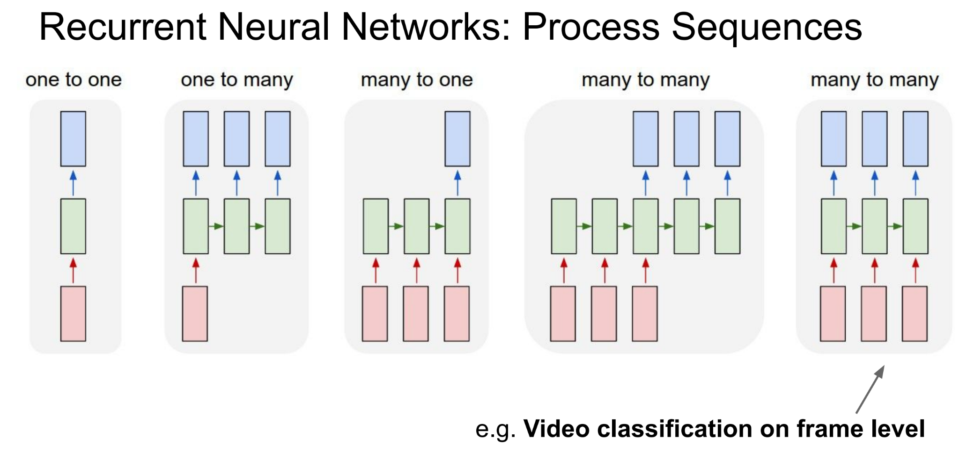
Recurrent Neural Network

Slide 11
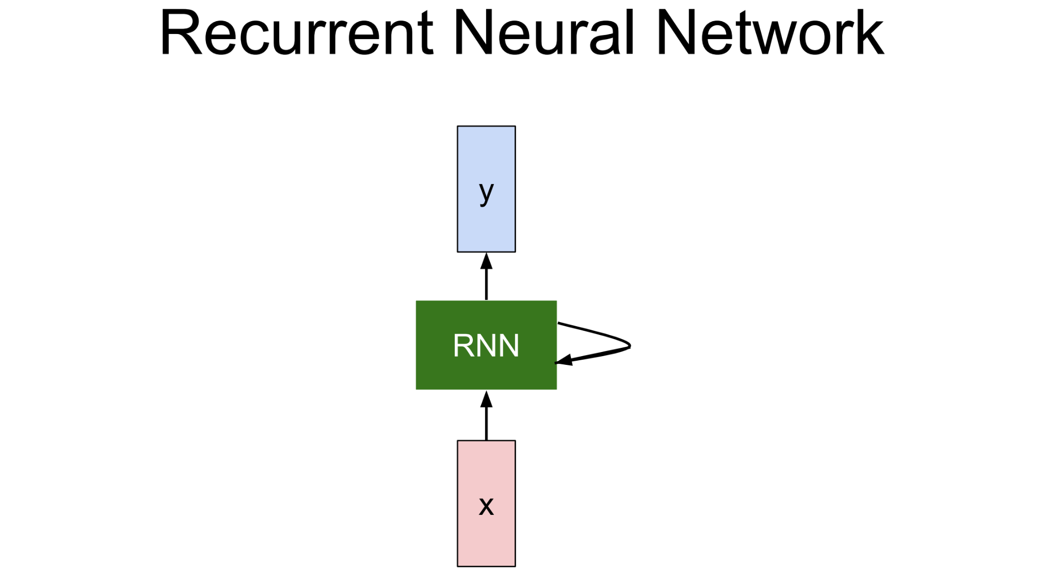
Recurrent Neural Network

Slide 12
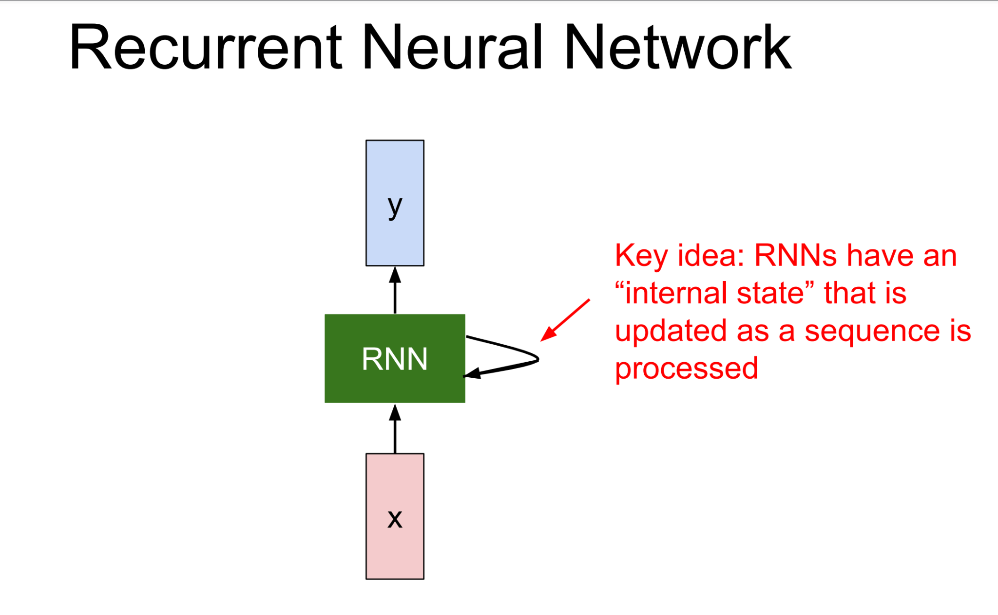
Recurrent Neural Network

Slide 13
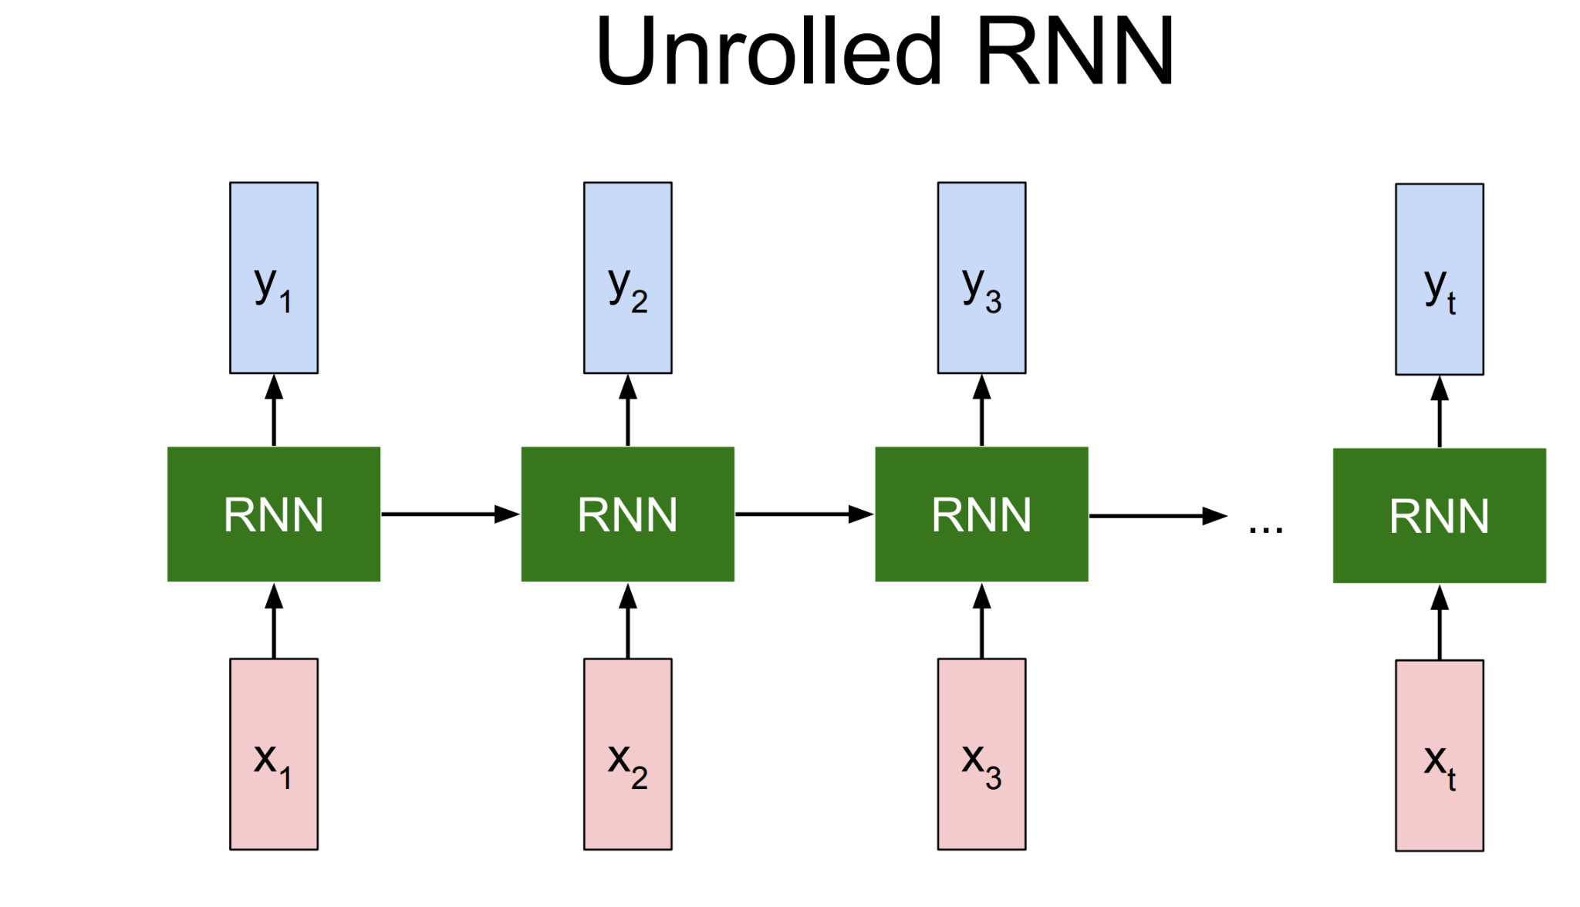
Recurrent Neural Network

Slide 14
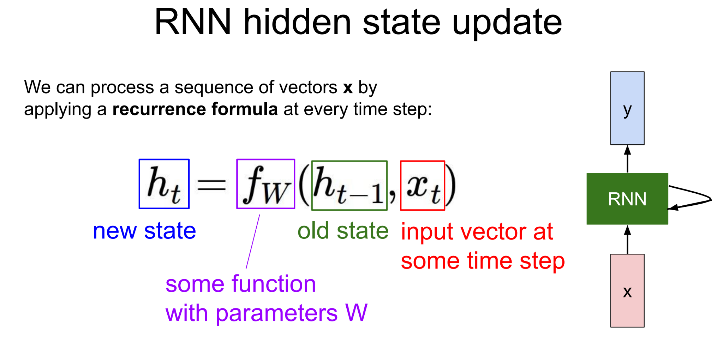
Recurrent Neural Network

Slide 15
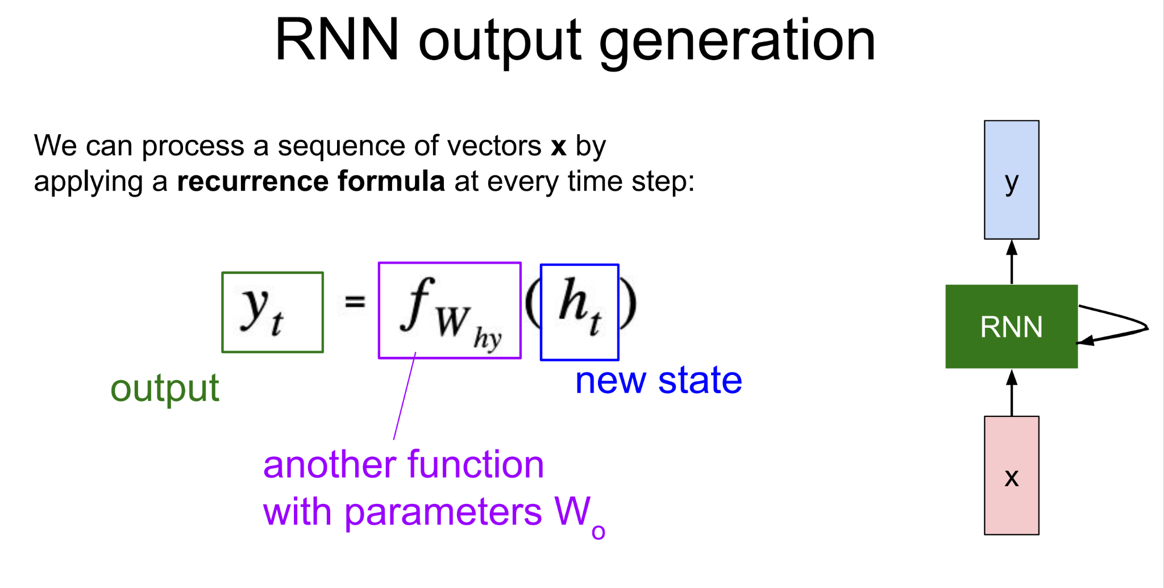
Recurrent Neural Network

Slide 16
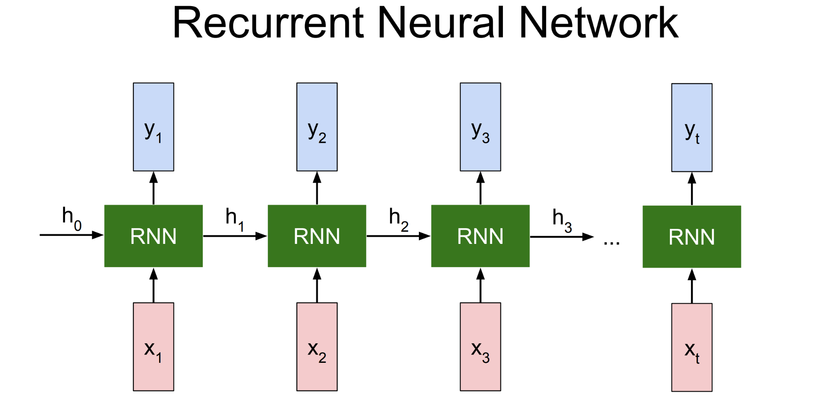
Recurrent Neural Network

Slide 17
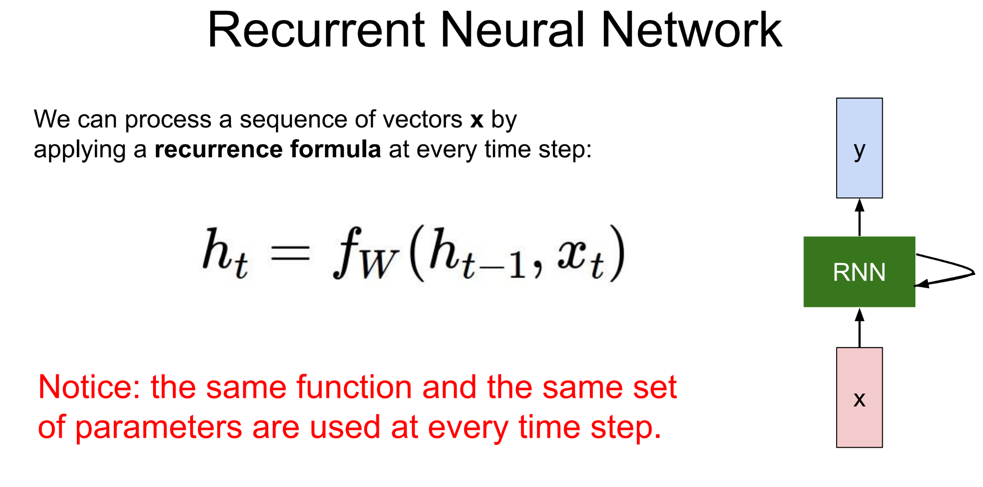
Recurrent Neural Network

Slide 18
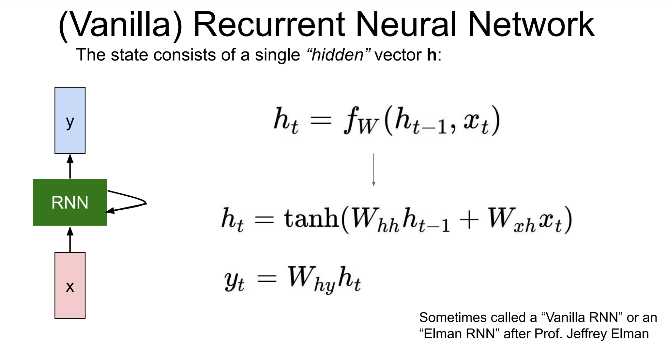
Recurrent Neural Network

Slide 19
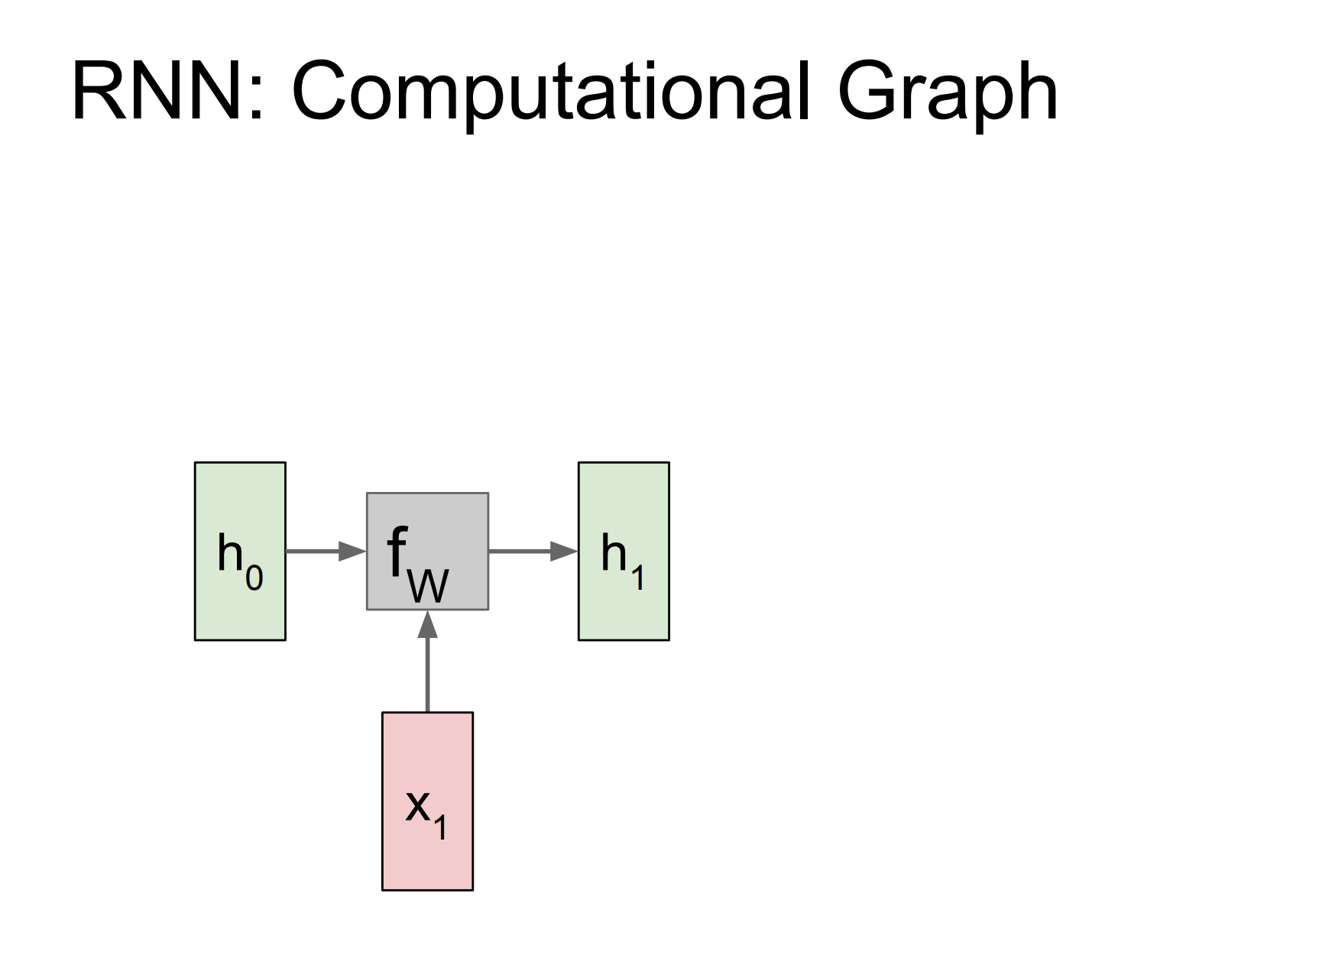
Recurrent Neural Network

Slide 20
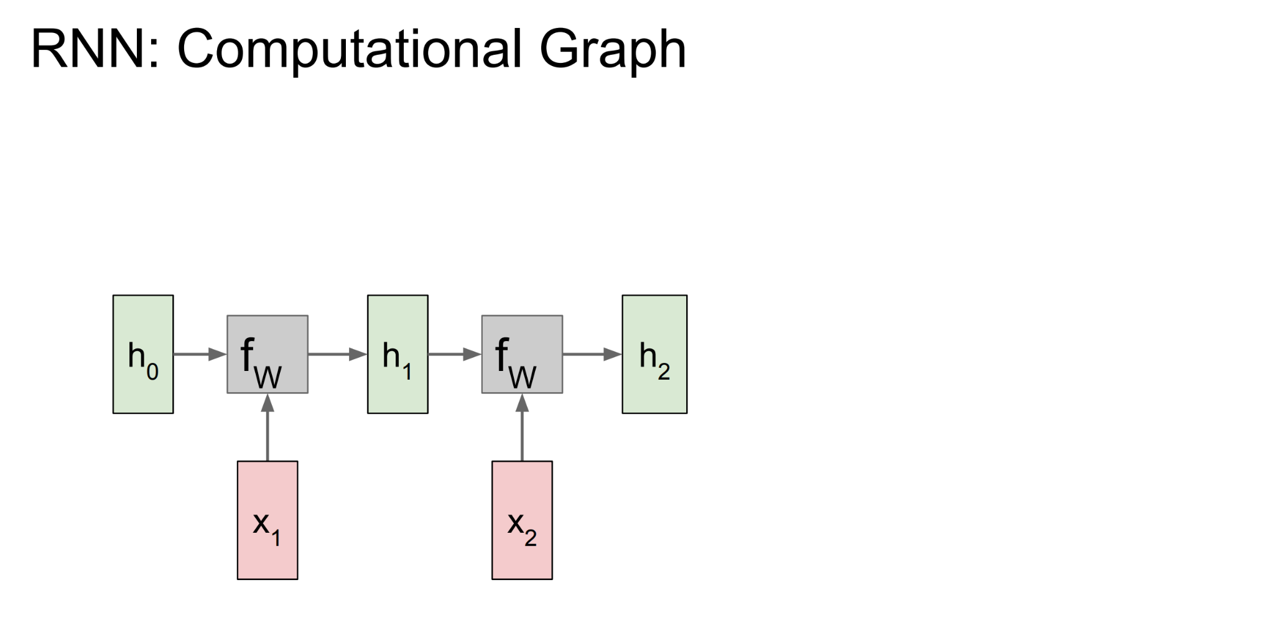
Recurrent Neural Network

Slide 21
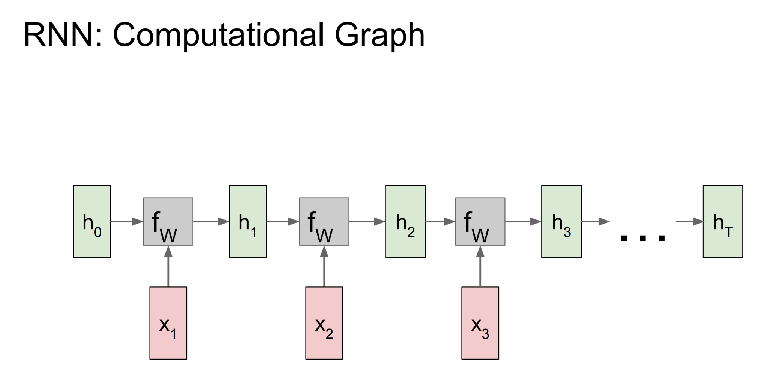
Recurrent Neural Network

Slide 22
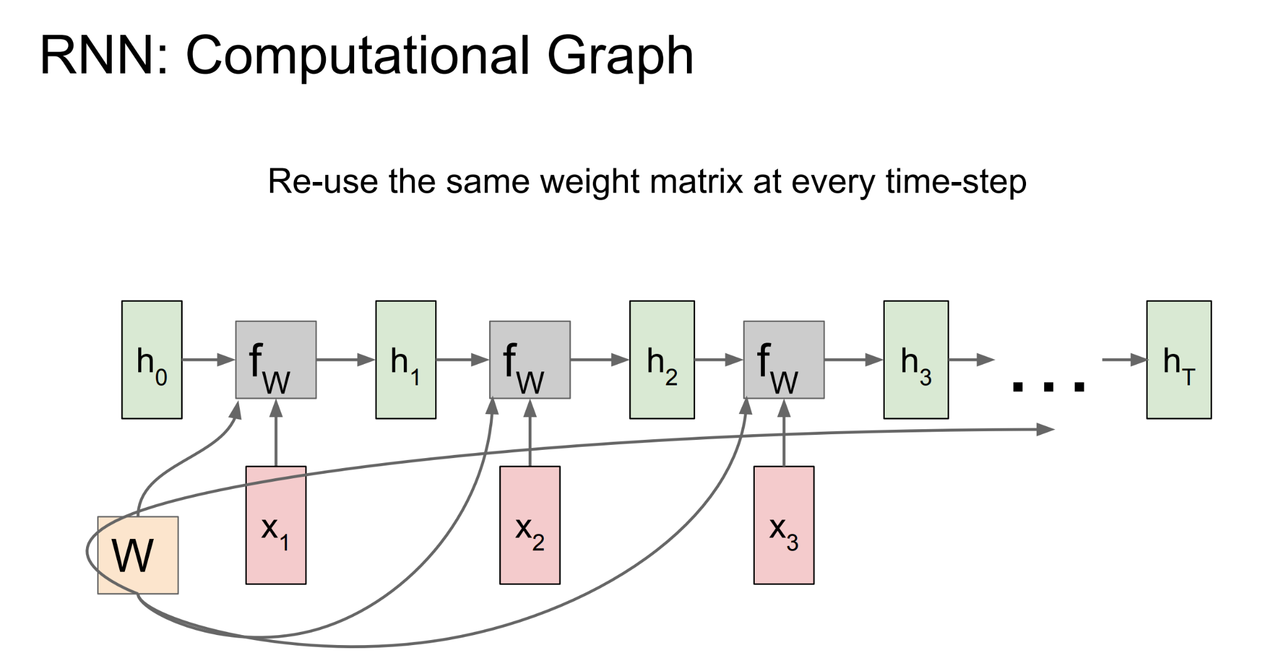
Recurrent Neural Network

Slide 23
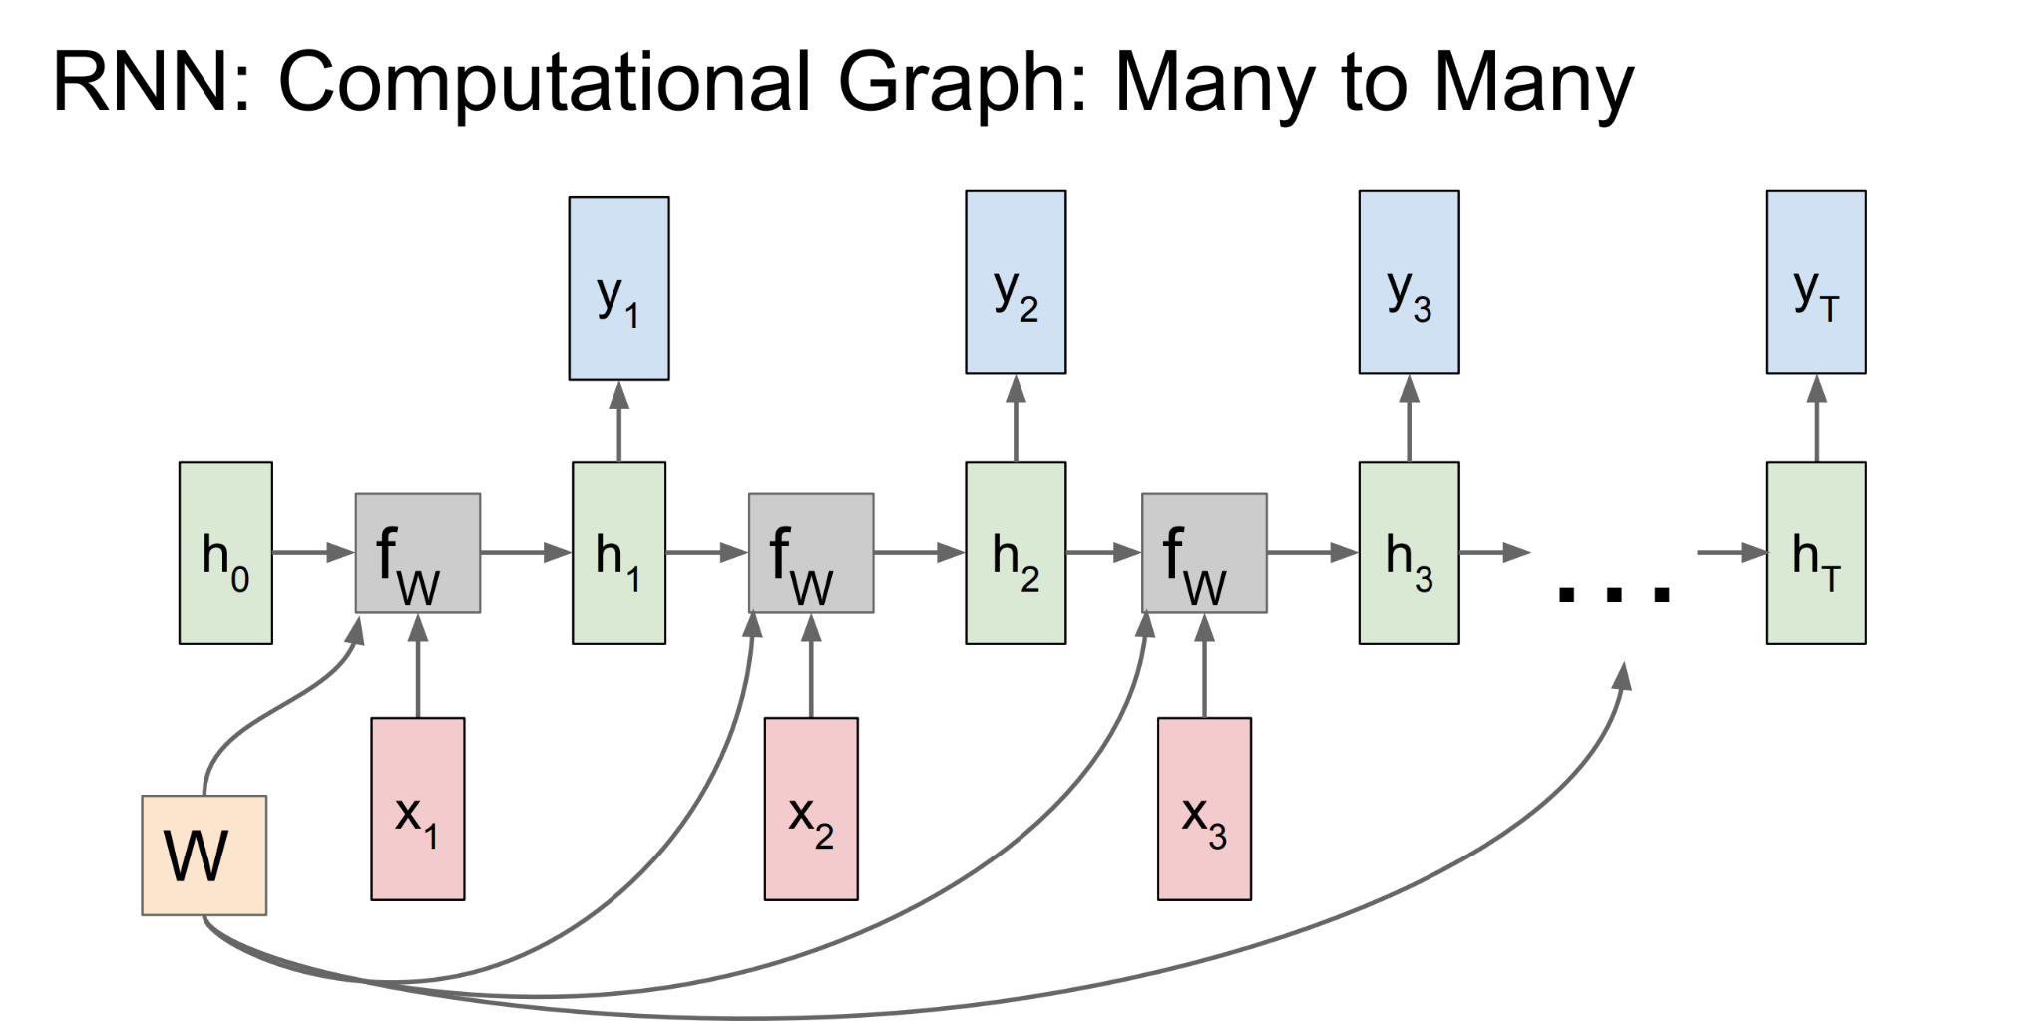
Recurrent Neural Network

Slide 24
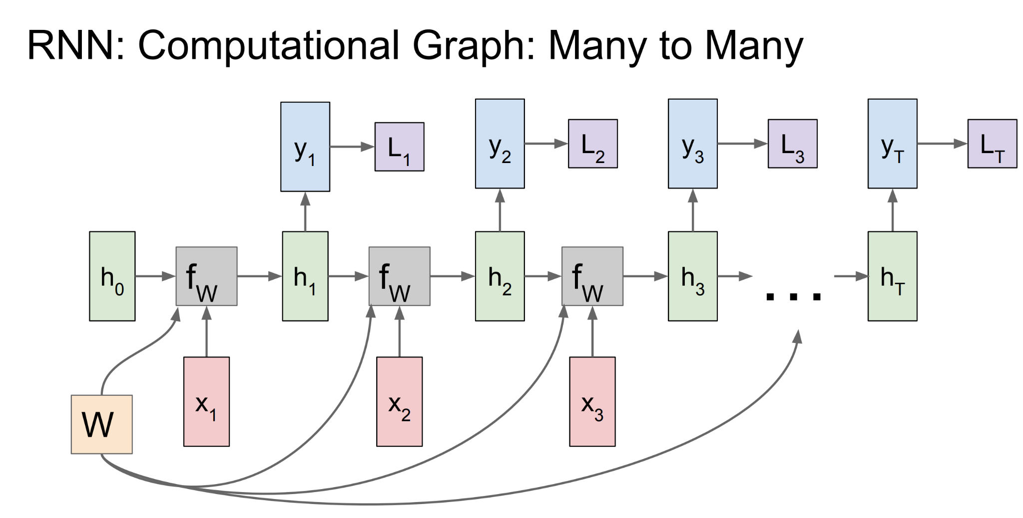
Recurrent Neural Network

Slide 25
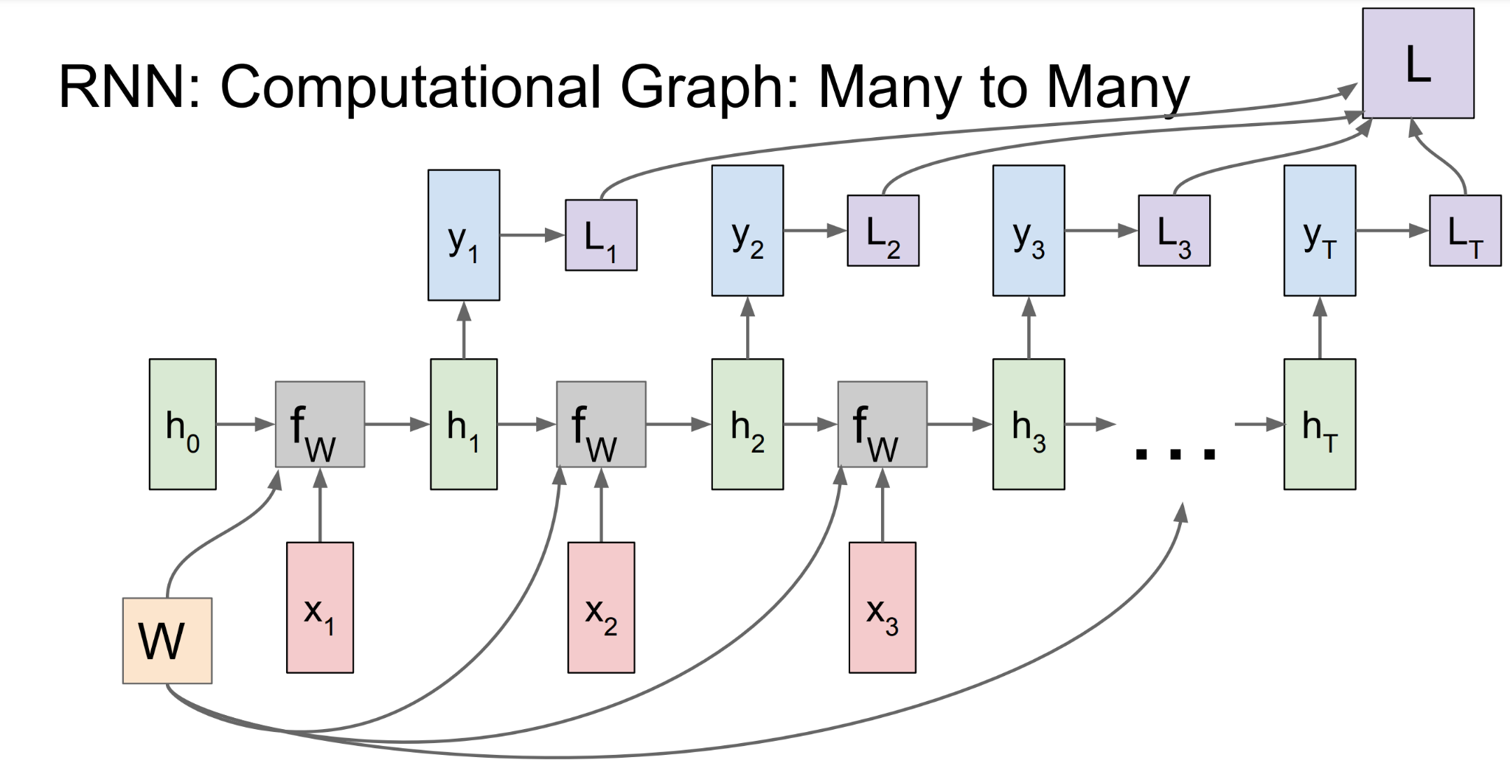
Recurrent Neural Network

Slide 26
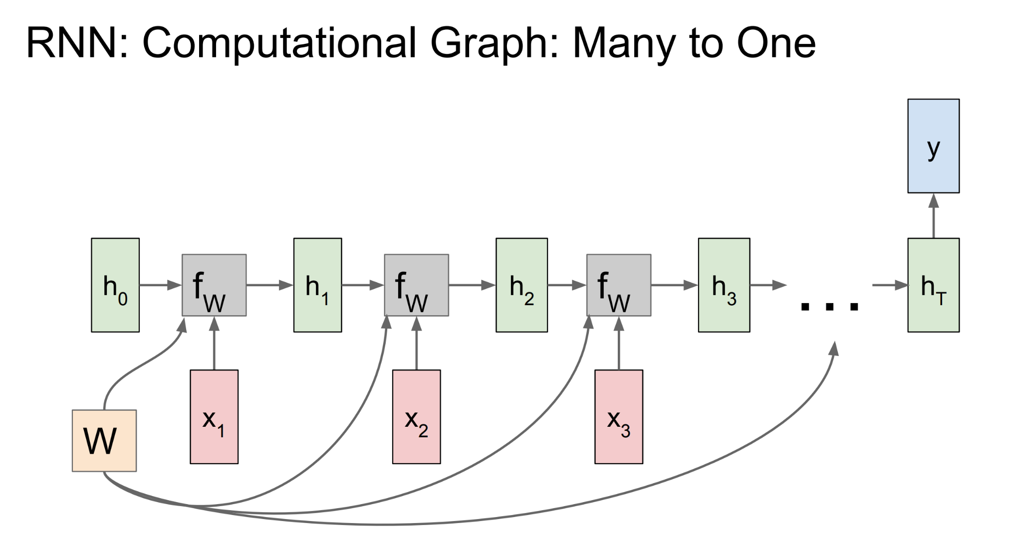
Recurrent Neural Network

Slide 27
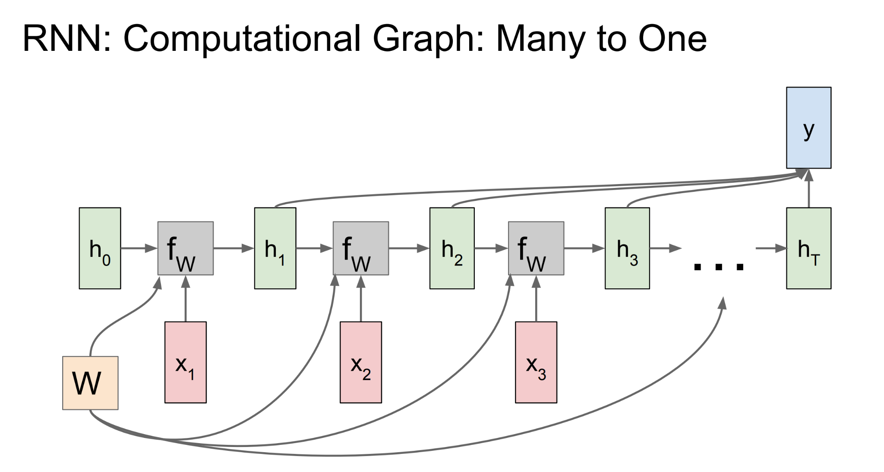
Recurrent Neural Network

Slide 28
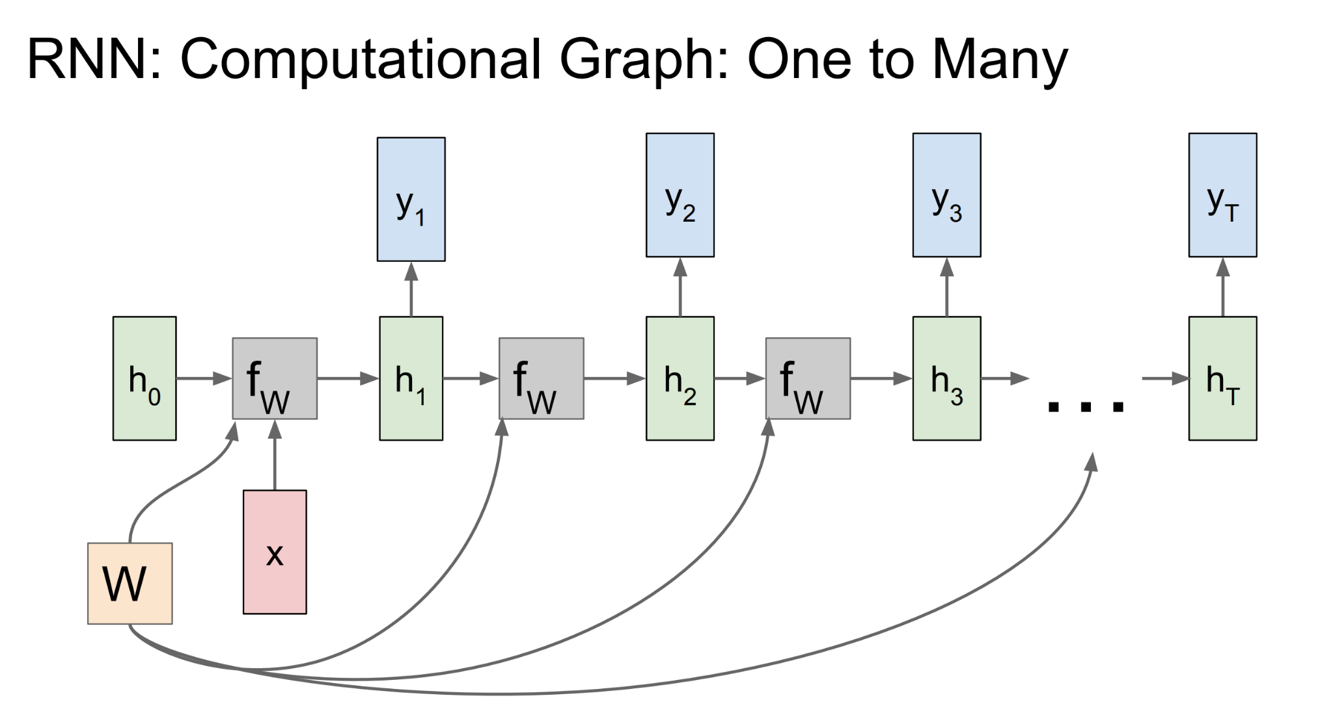
Recurrent Neural Network

Slide 29
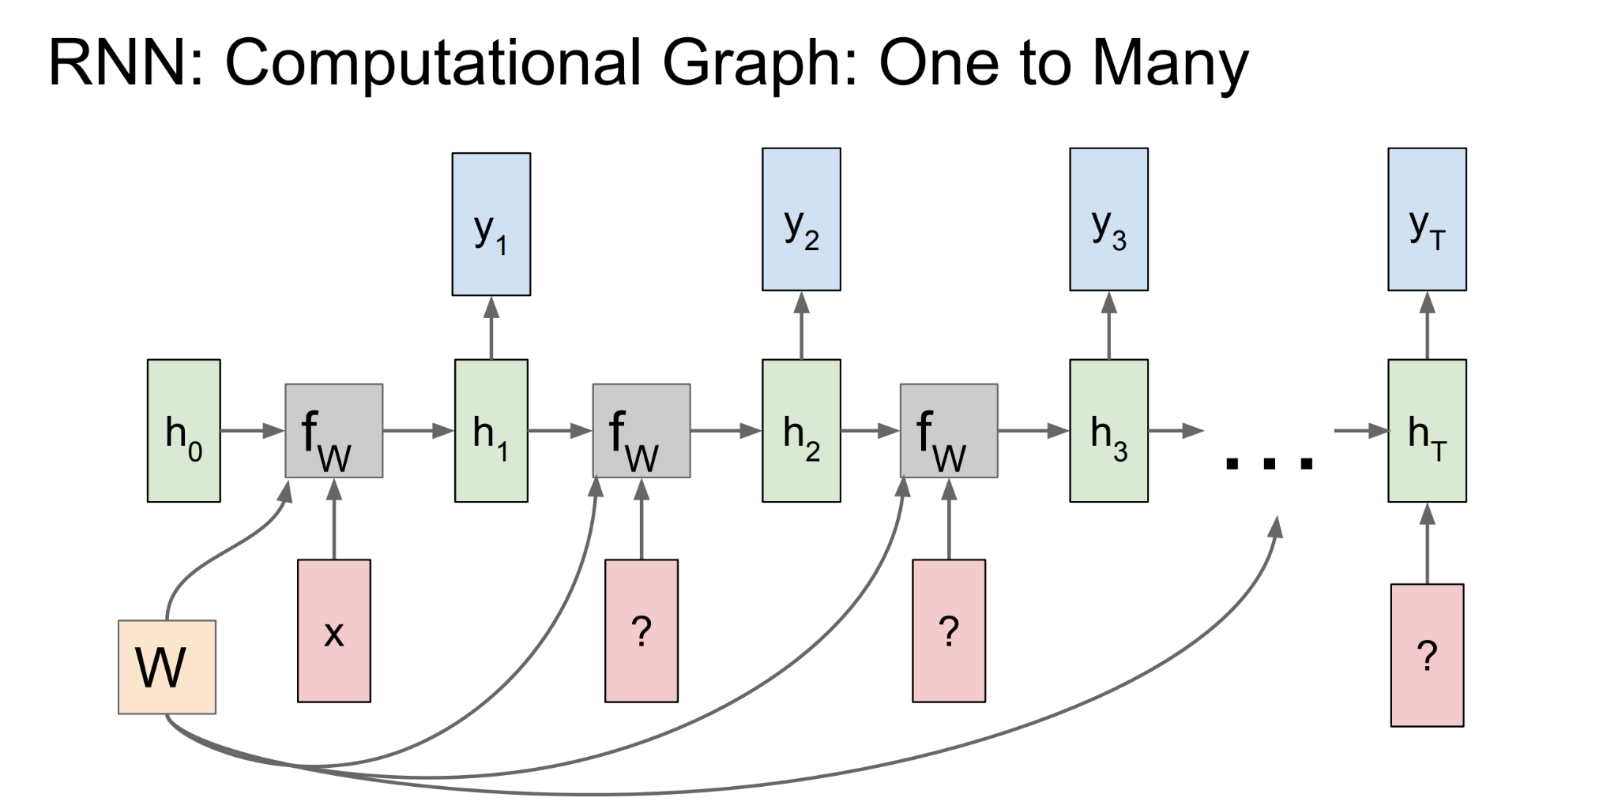
Recurrent Neural Network

Slide 30
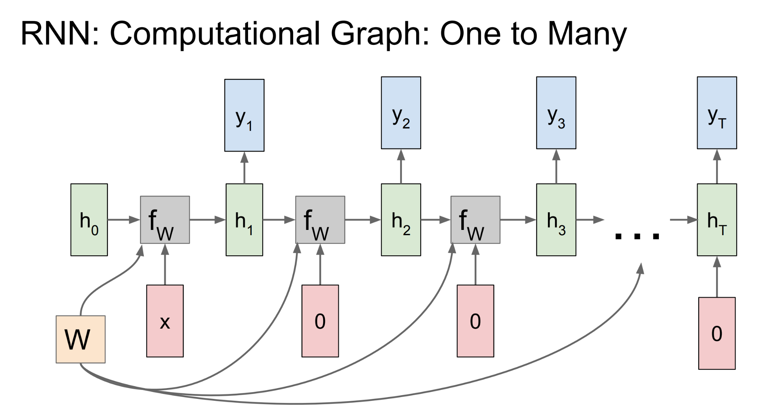
Recurrent Neural Network

Slide 31
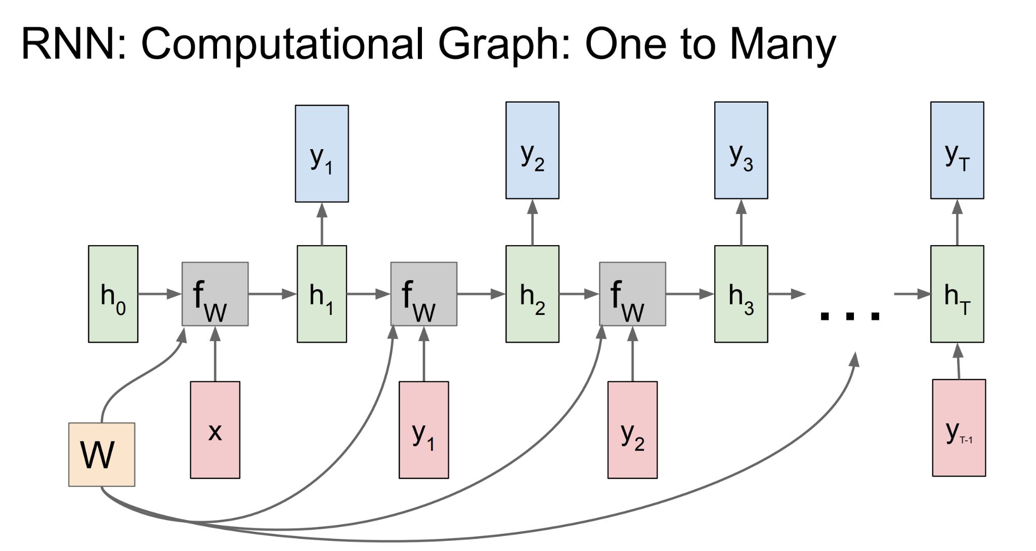
Recurrent Neural Network

Slide 32
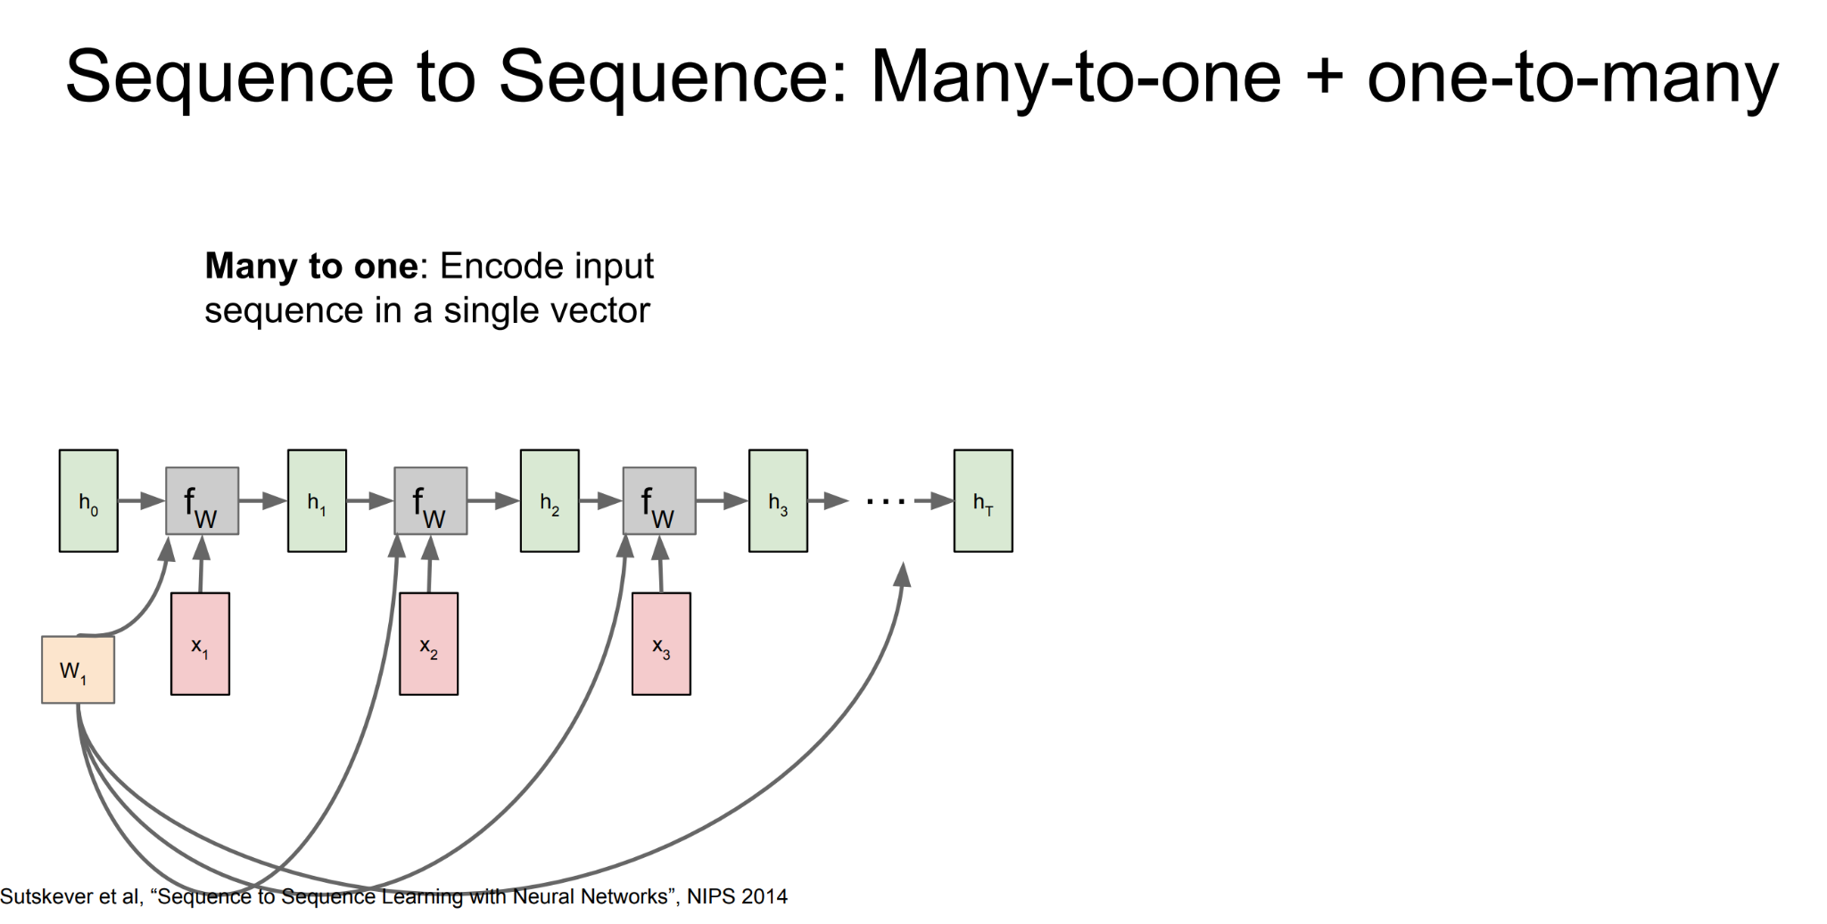
Recurrent Neural Network

Slide 33
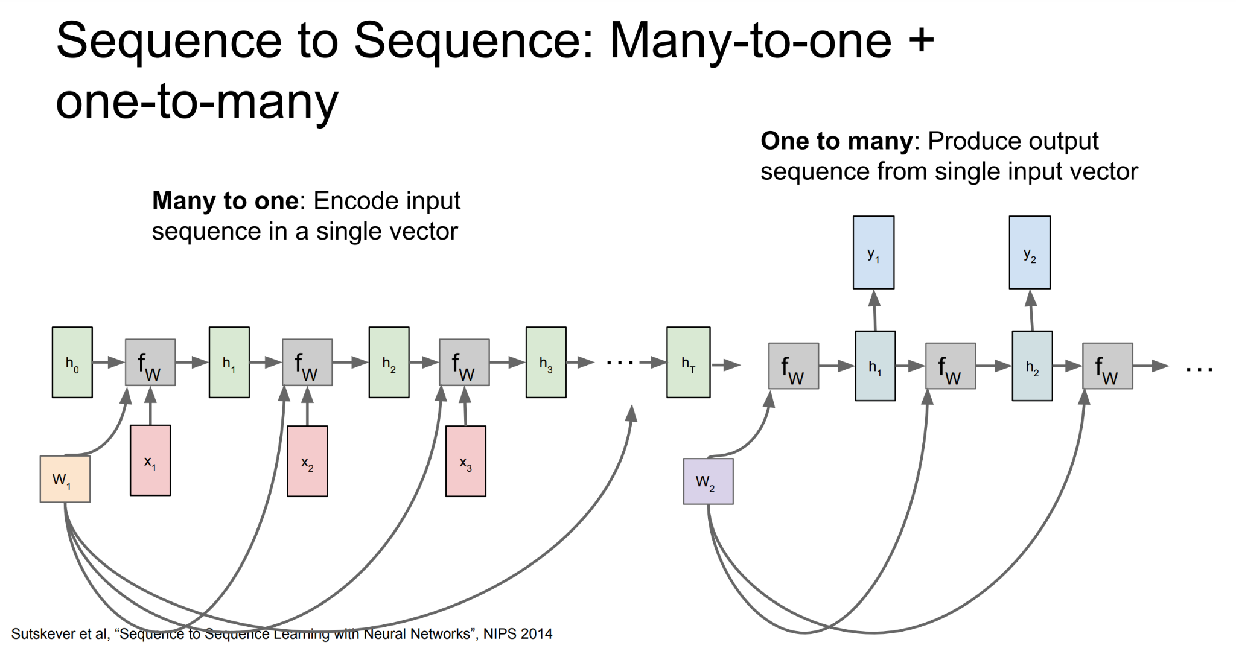
Recurrent Neural Network

Slide 34
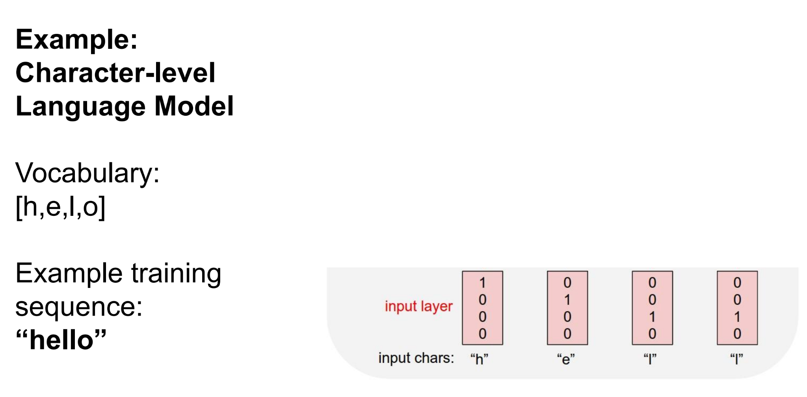
Recurrent Neural Network

Slide 35
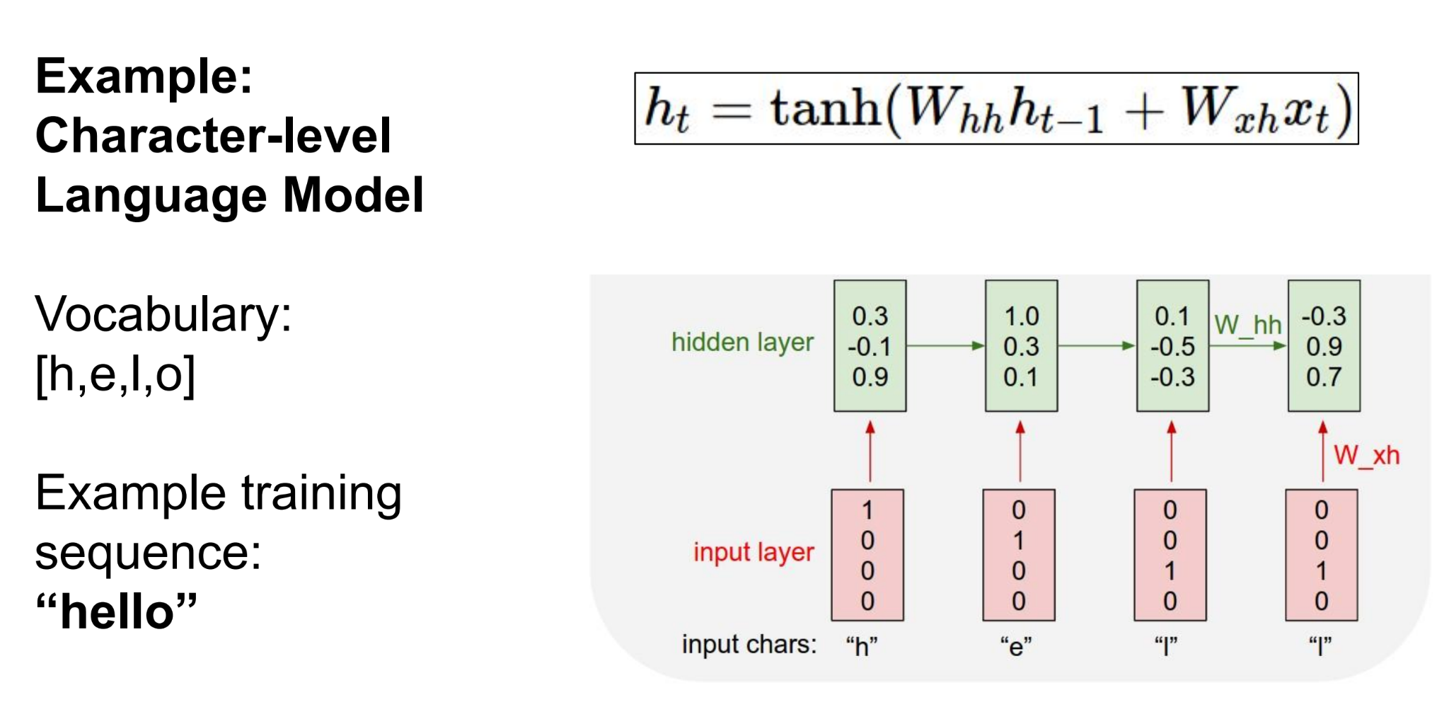
Recurrent Neural Network

Slide 36
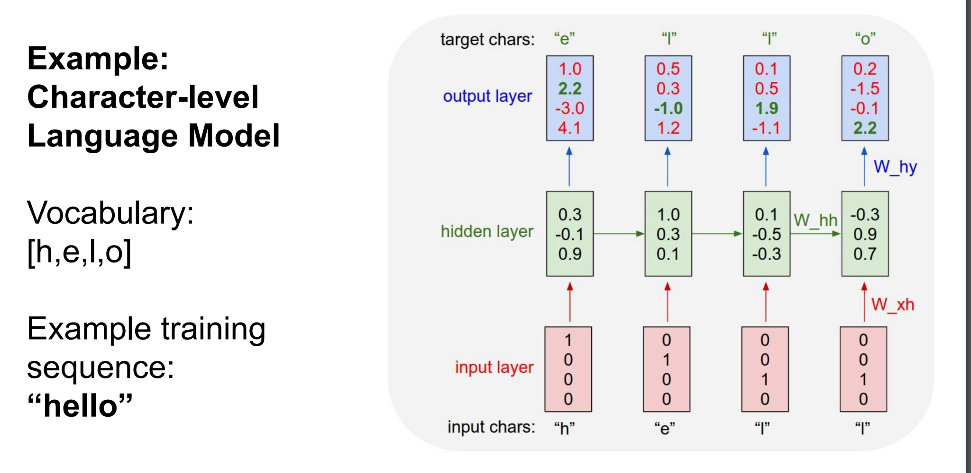
Recurrent Neural Network

Slide 37
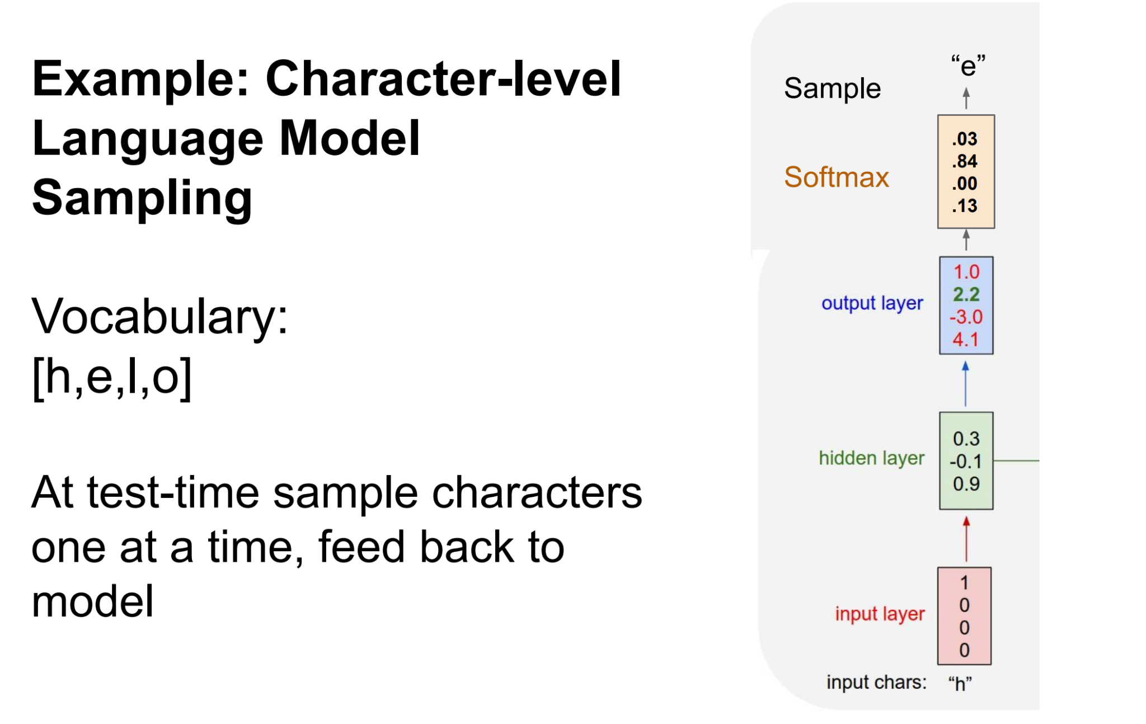
Recurrent Neural Network

Slide 38
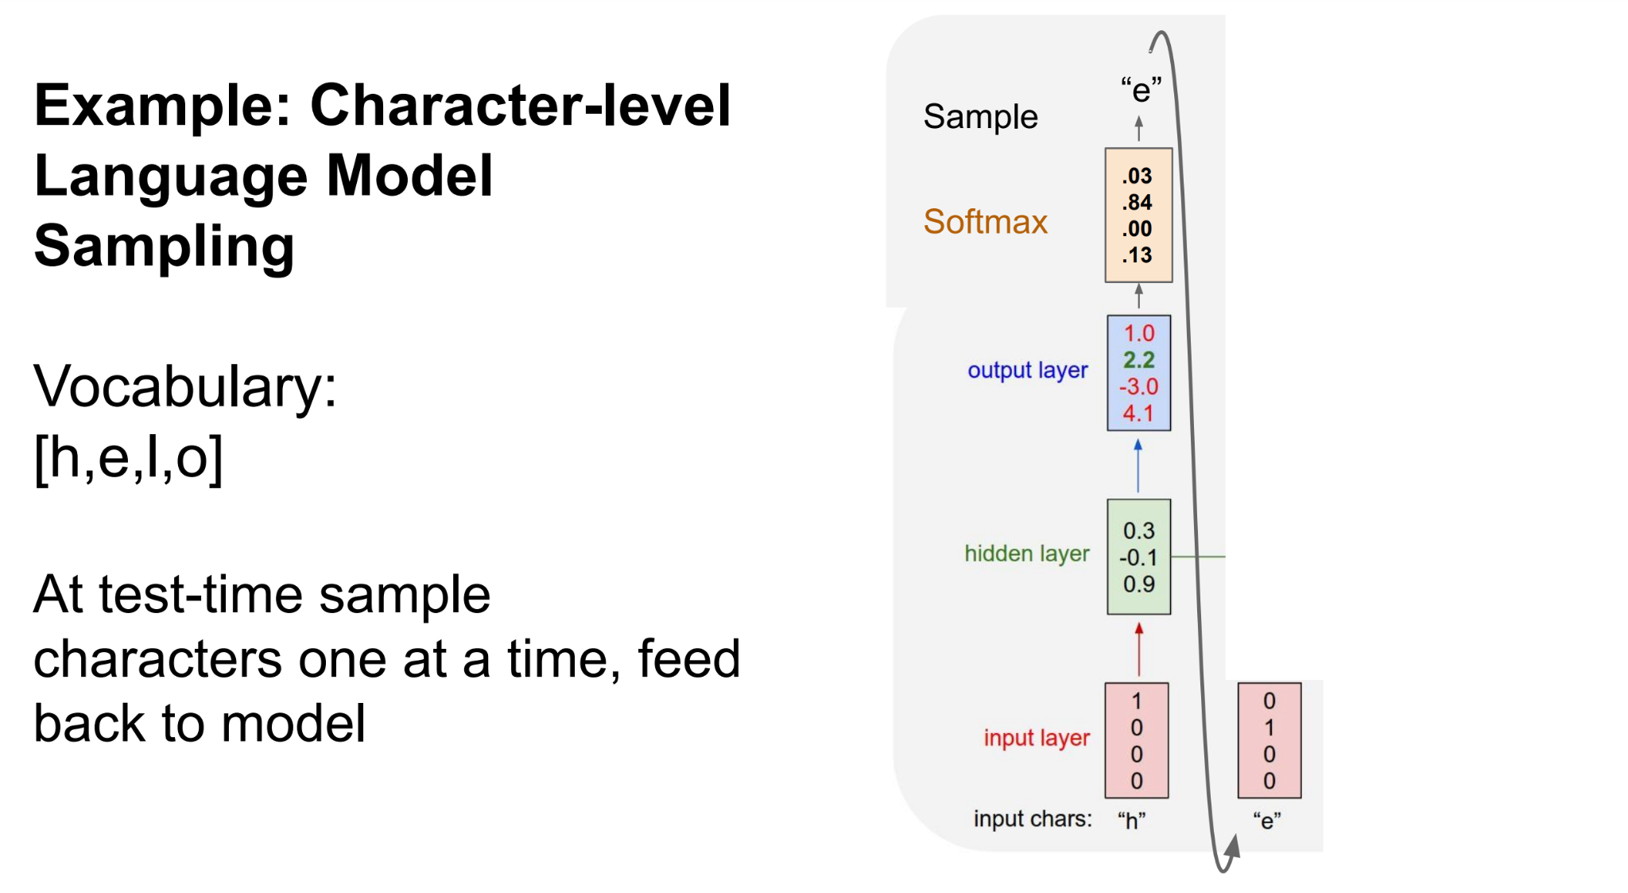
Recurrent Neural Network

Slide 39
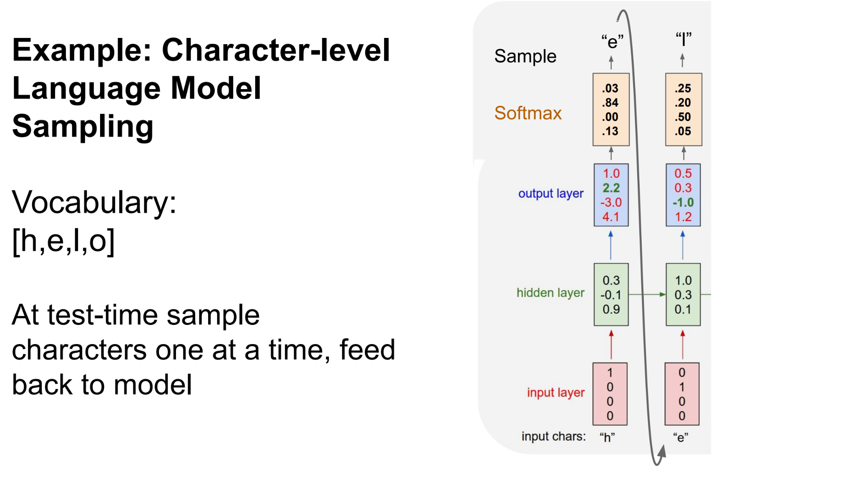
Recurrent Neural Network

Slide 40
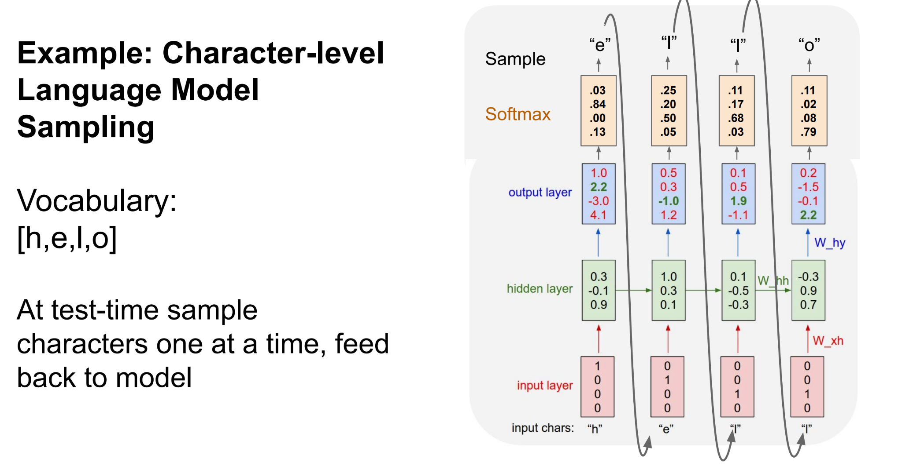
Recurrent Neural Network

Slide 41
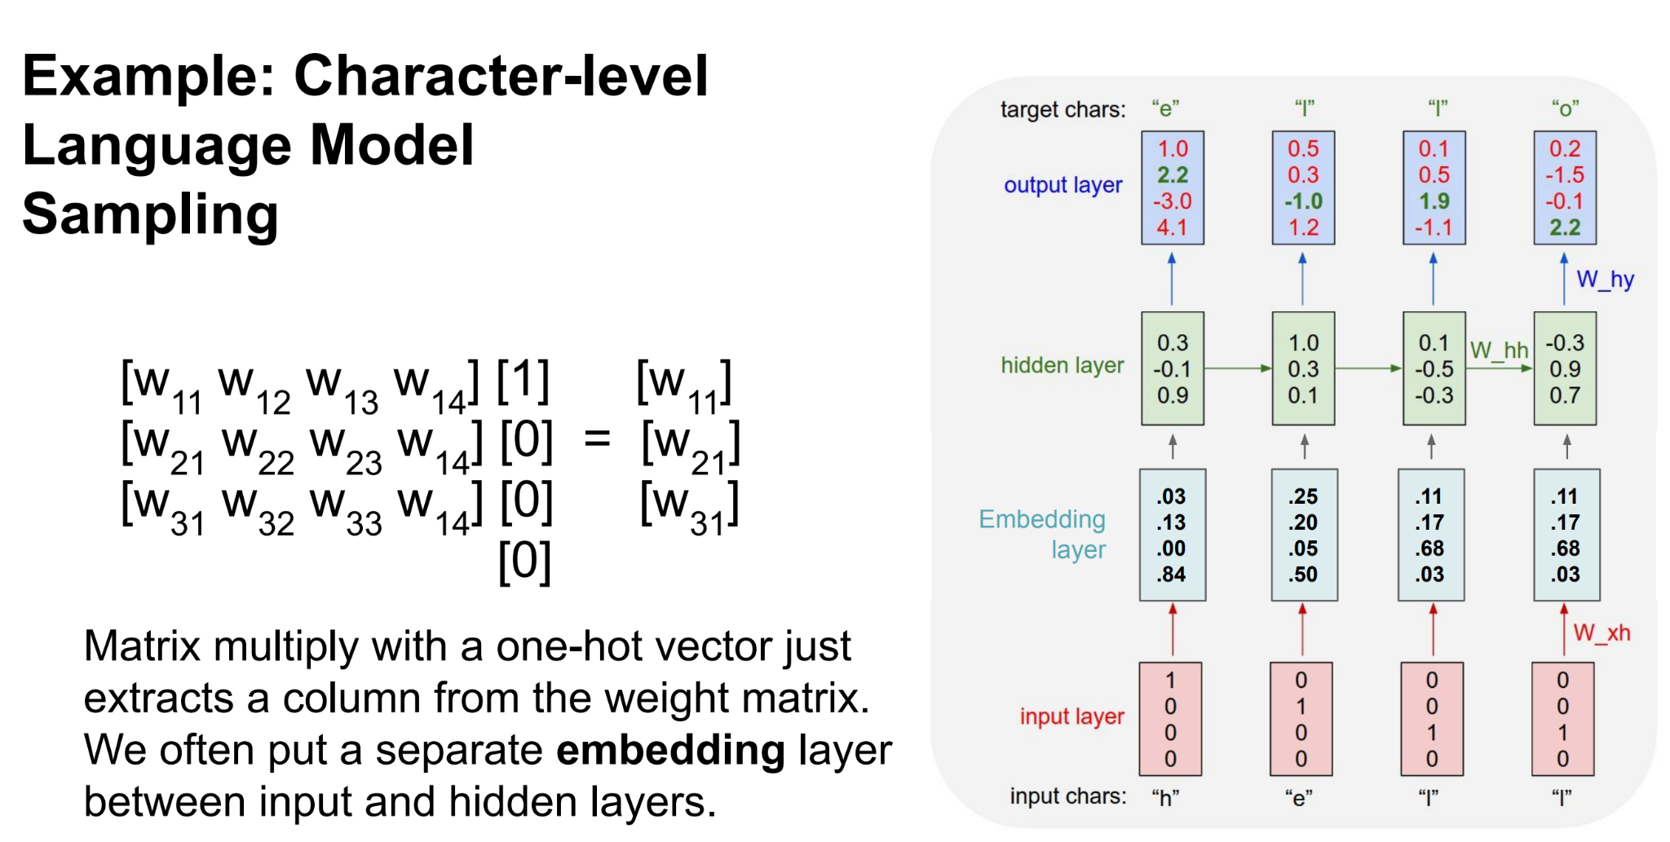
Recurrent Neural Network

Slide 42
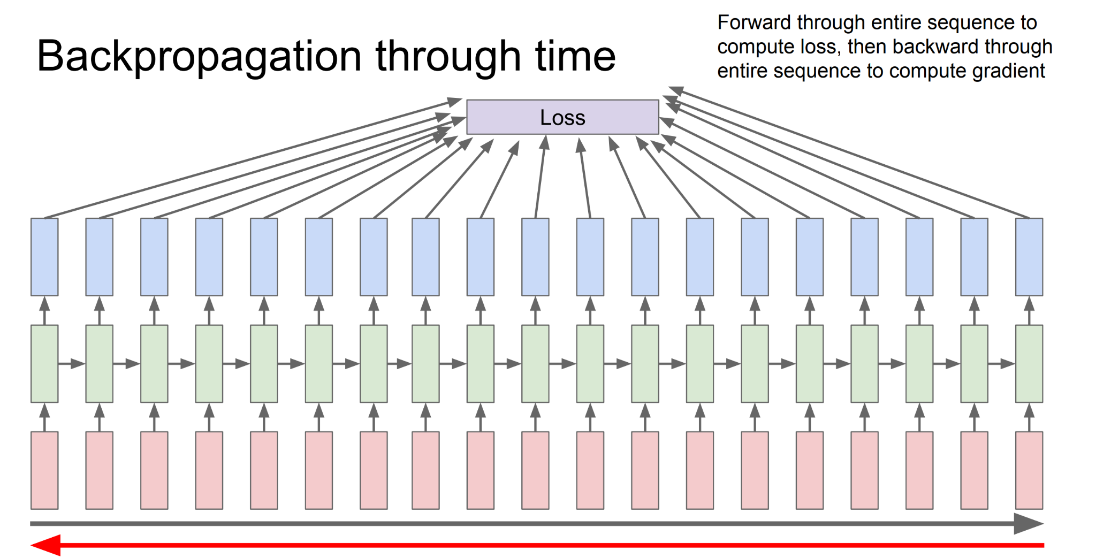
Recurrent Neural Network

Slide 43
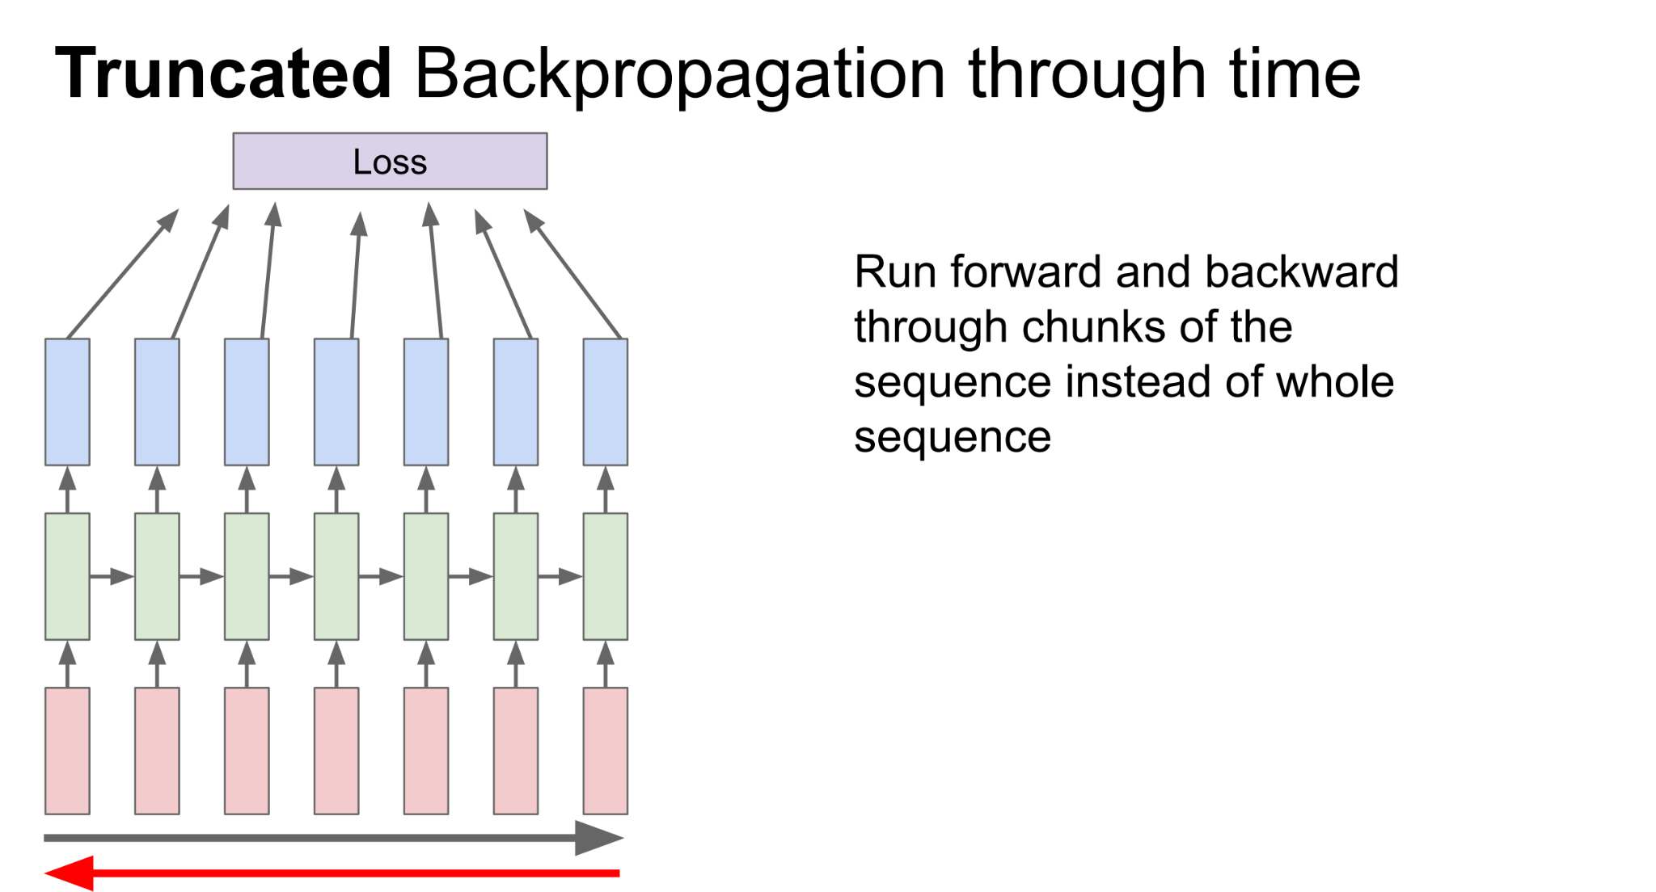
Recurrent Neural Network

Slide 44
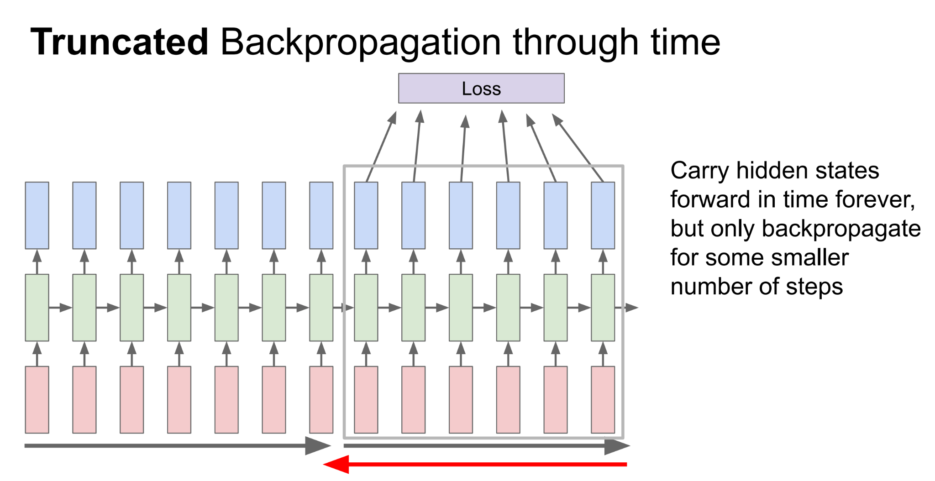
Recurrent Neural Network

Slide 45
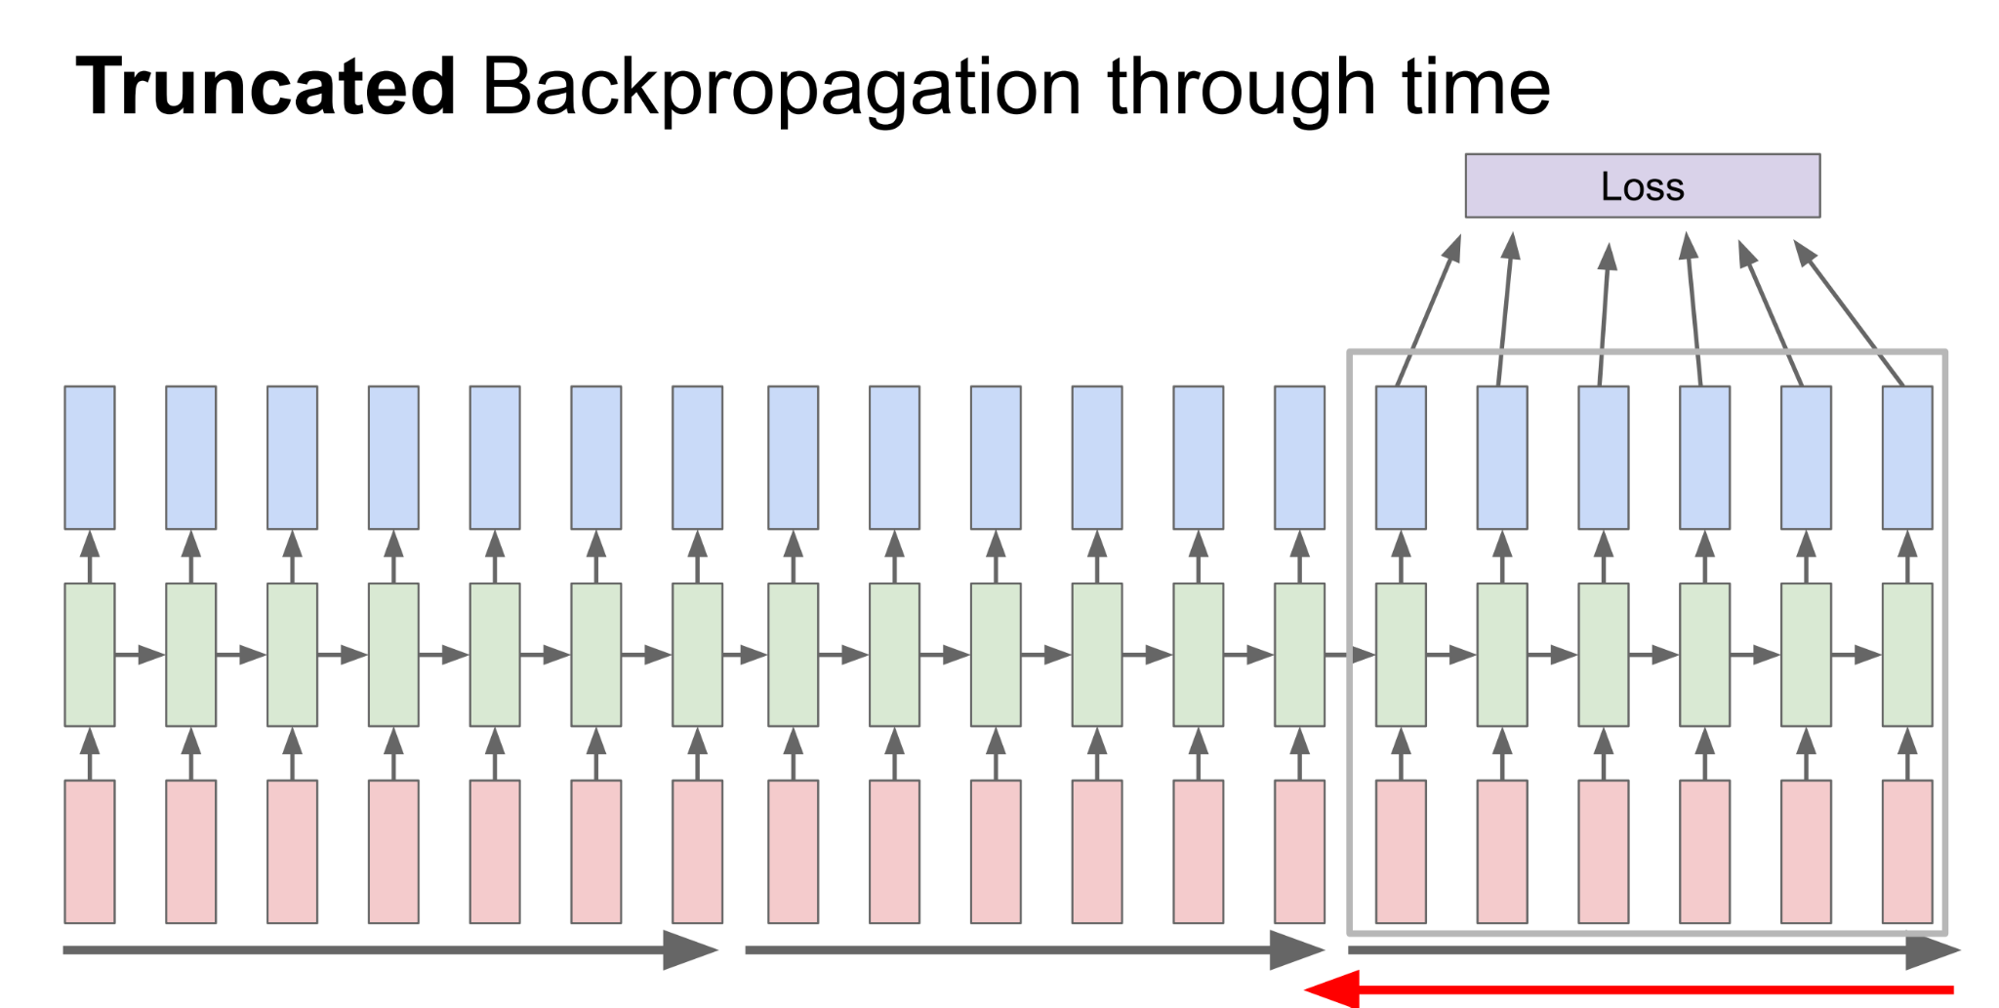
Recurrent Neural Network

Slide 46
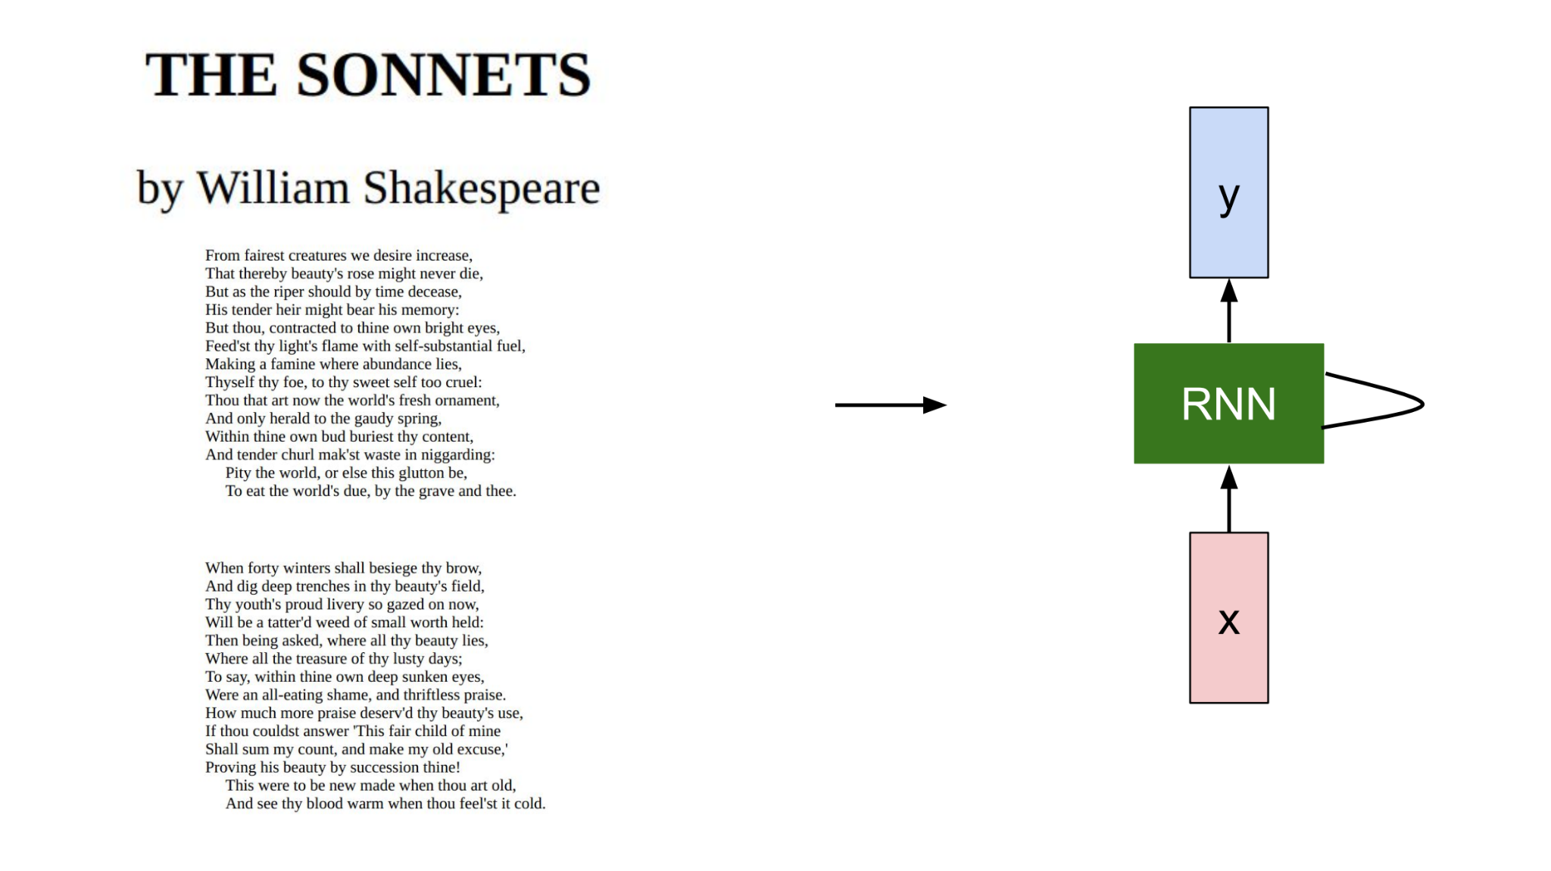
Recurrent Neural Network

Slide 47
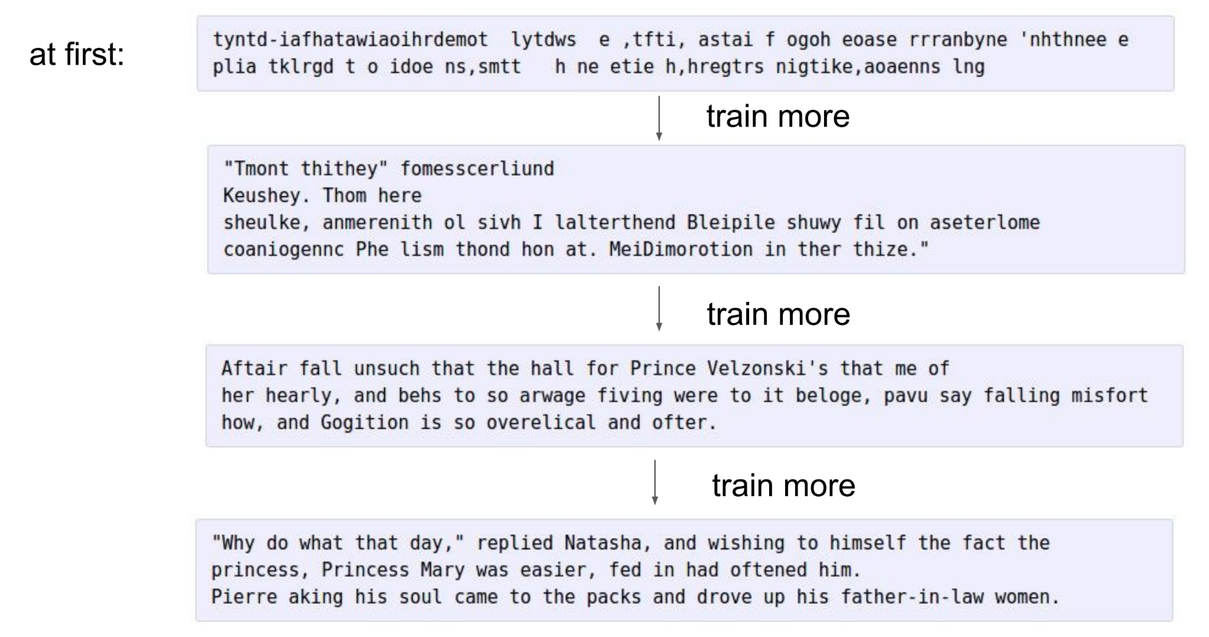
Recurrent Neural Network

Slide 48
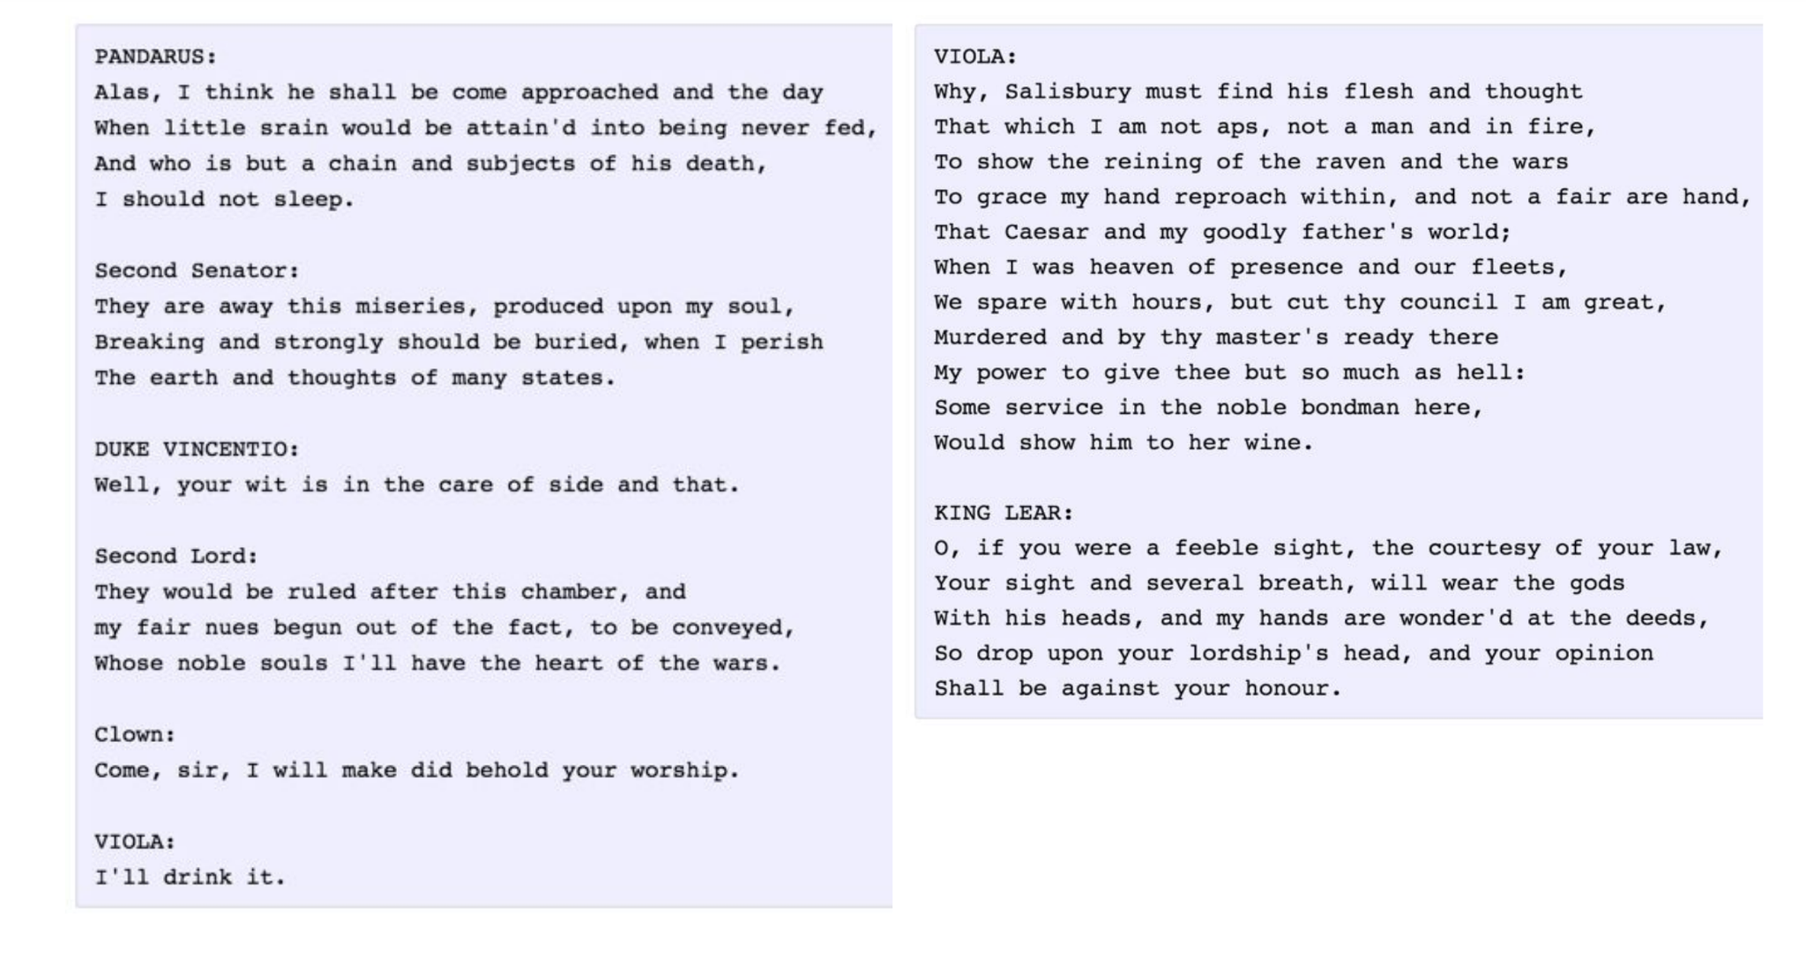
Recurrent Neural Network

Slide 49
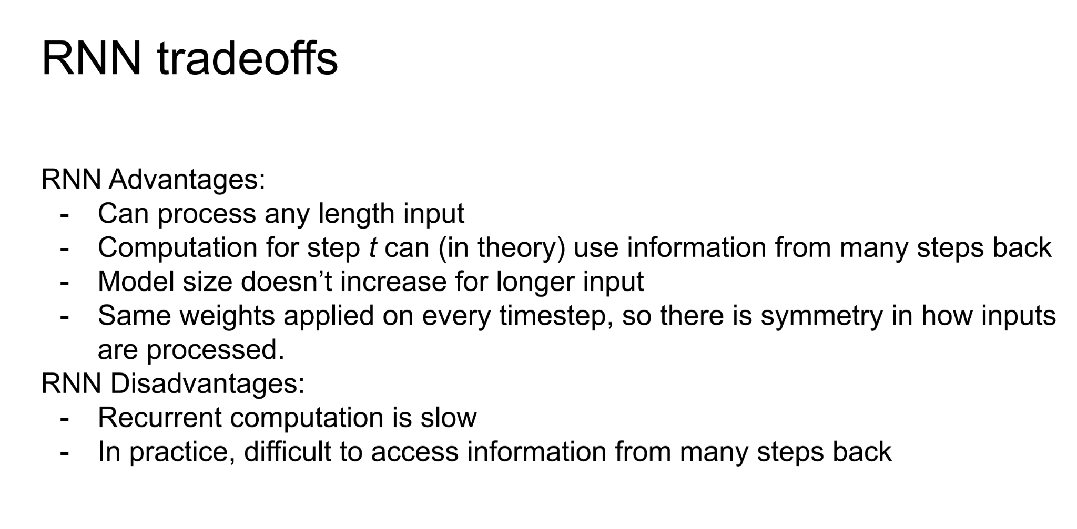
Recurrent Neural Network

Slide 50
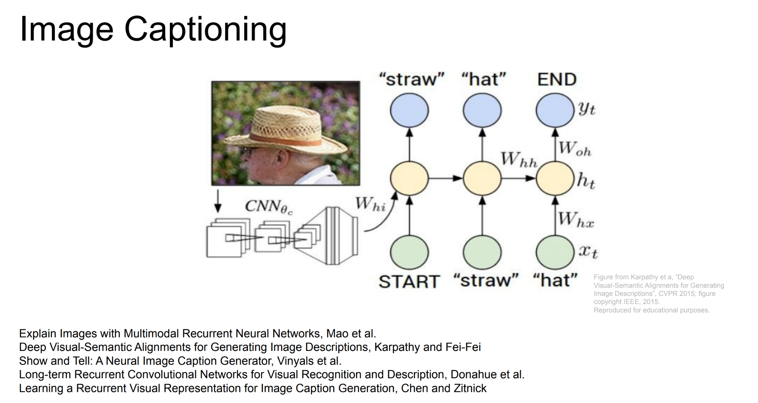
Image Captioning

Slide 51
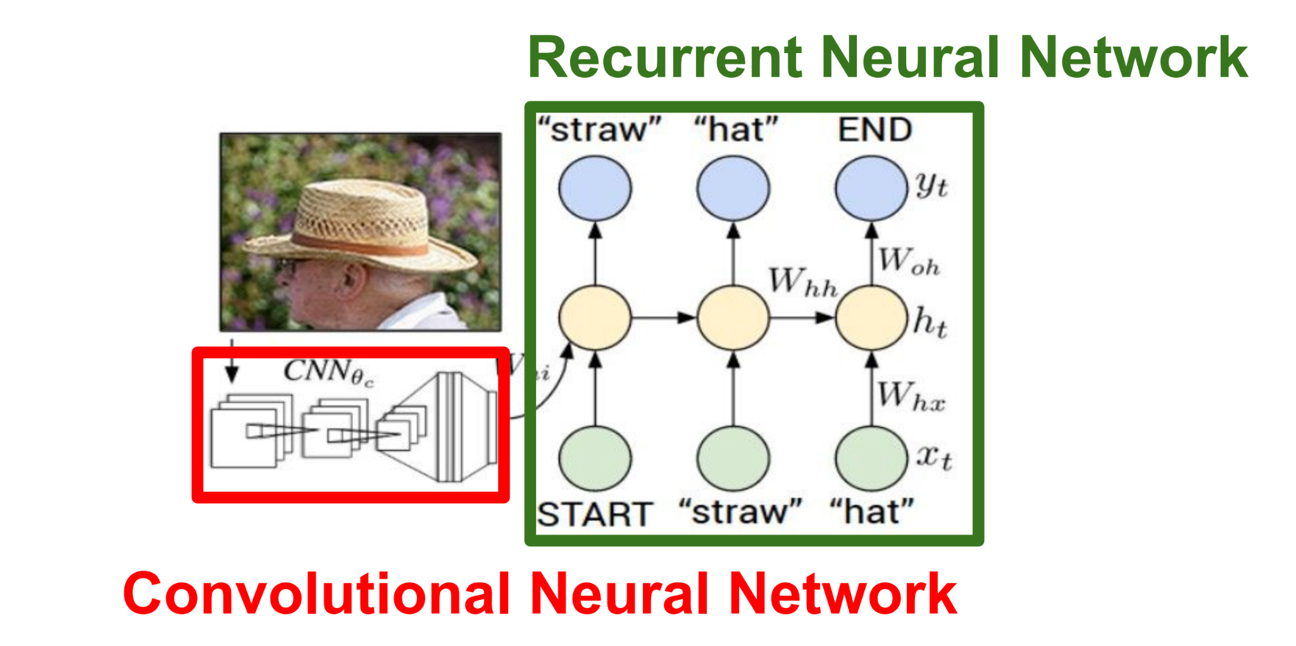
Image Captioning

Slide 52
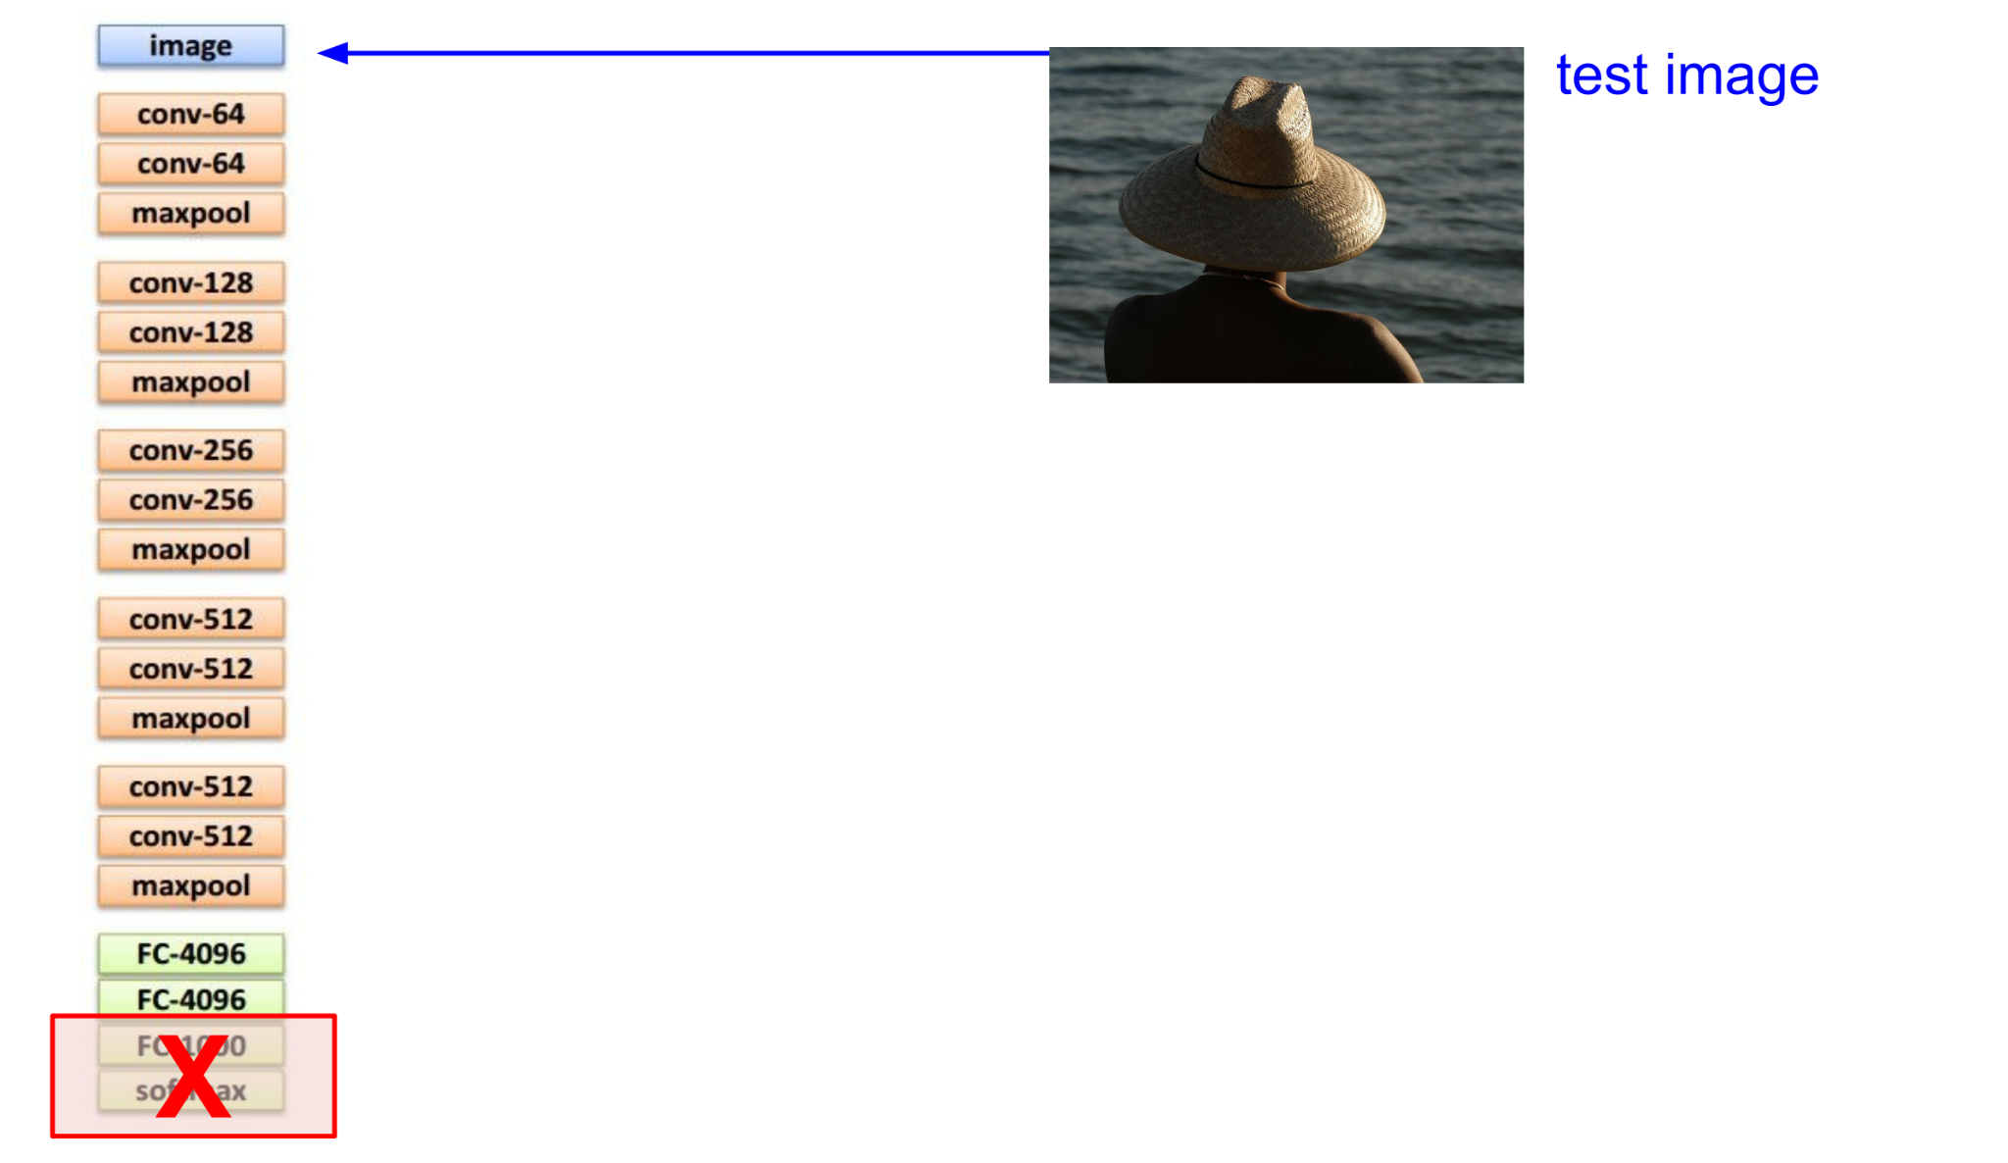
Image Captioning

Slide 53
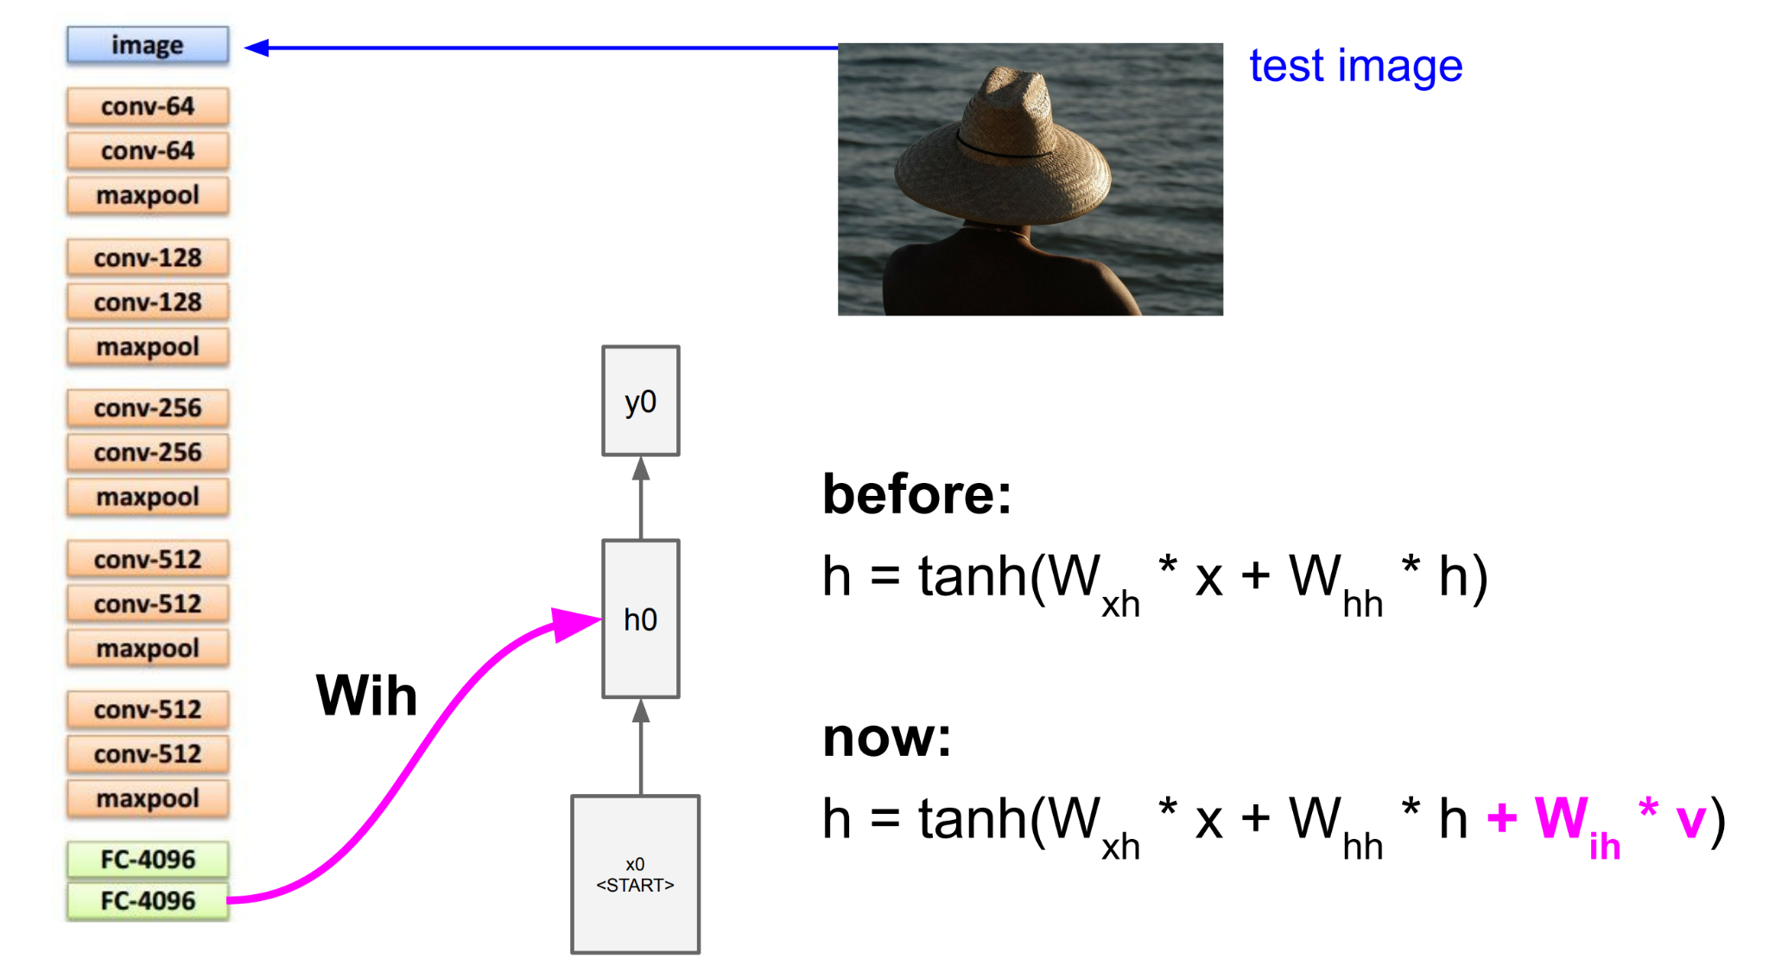
Image Captioning

Slide 54
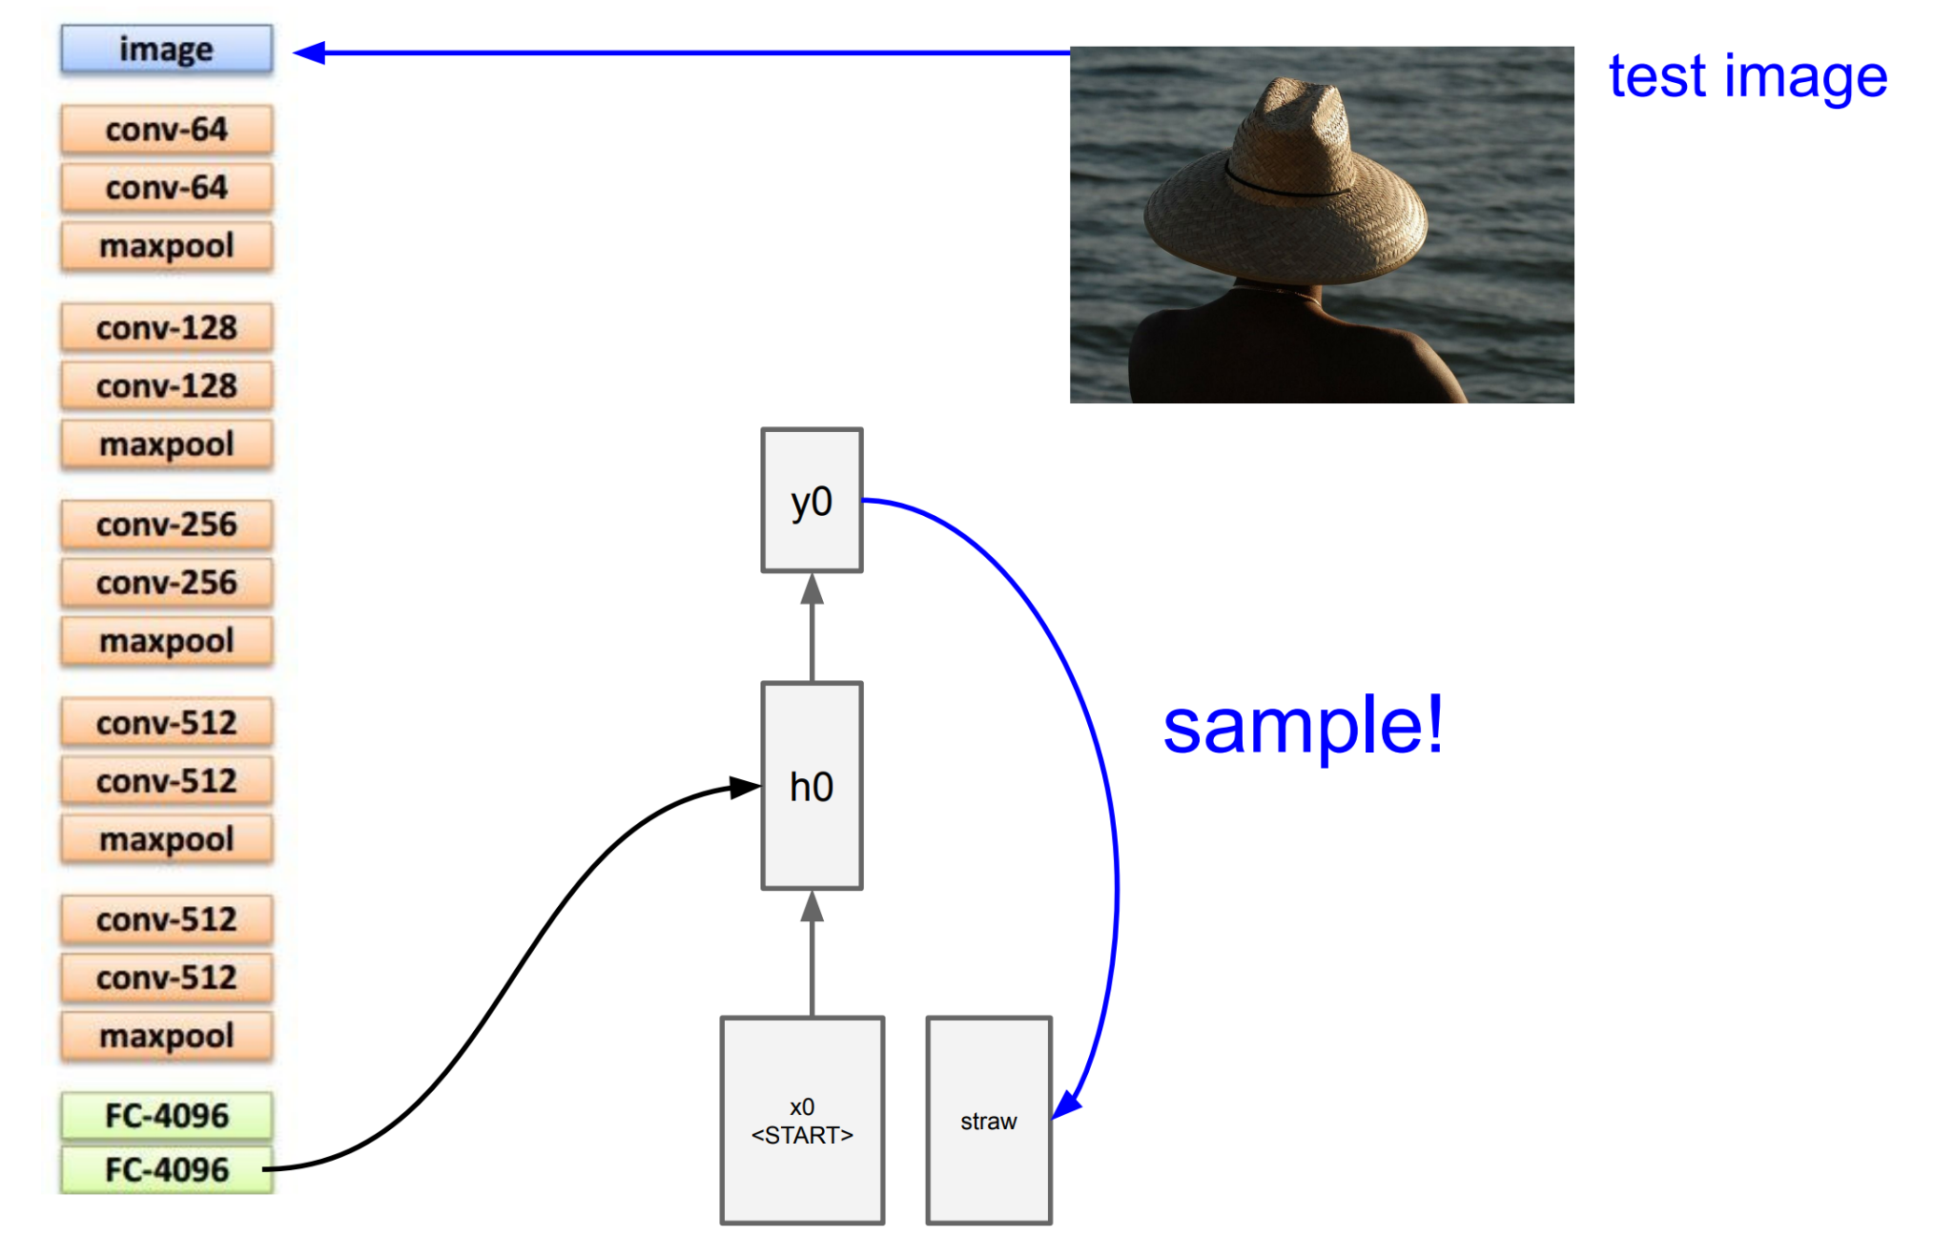
Image Captioning

Slide 55
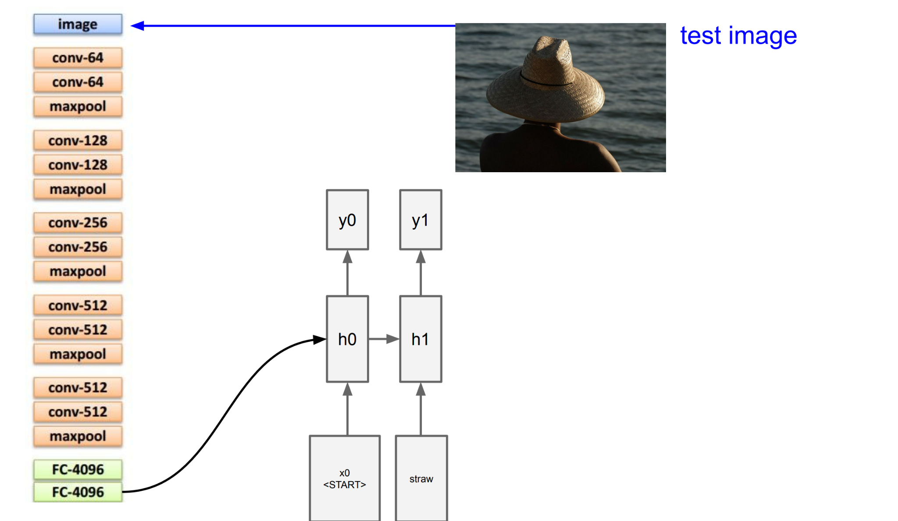
Image Captioning

Slide 56

Image Captioning

Slide 57

Image Captioning

Slide 58

Image Captioning

Slide 59

Visual Question Answering

Slide 60

Visual Question Answering

Slide 61

Visual Question Answering

Slide 62

Visual Question Answering

Slide 63

Multilayer RNN

Slide 64

Long Short Term memory (LSTM)

Slide 65

Vanilla RNN Gradient Flow

Slide 66

Vanilla RNN Gradient Flow

Slide 67

Vanilla RNN Gradient Flow

Slide 68

Vanilla RNN Gradient Flow

Slide 69

Vanilla RNN Gradient Flow

Slide 70

Vanilla RNN Gradient Flow

Slide 71

Vanilla RNN Gradient Flow

Slide 72

Vanilla RNN Gradient Flow

Slide 73

Vanilla RNN Gradient Flow

Slide 74

Vanilla RNN Gradient Flow

Slide 75

Vanilla RNN Gradient Flow

Slide 76

Vanilla RNN Gradient Flow

Slide 77

Vanishing and Exploding Gradients

Slide 78

Vanishing and Exploding Gradients

Slide 79

Vanishing and Exploding Gradients

Slide 80

Vanishing Gradient

Slide 81

Exploding Gradient

Slide 82

Exploding Gradient

Slide 83

Exploding Gradient

Slide 84

Long Short Term memory (LSTM)

Slide 85

Long Short Term memory (LSTM)

Slide 86

Long Short Term memory (LSTM)

Slide 87

Long Short Term memory (LSTM)

Slide 88

Long Short Term memory (LSTM)

Slide 89

Long Short Term memory (LSTM)

Slide 90

Long Short Term memory (LSTM)

Slide 91

Long Short Term memory (LSTM)

Slide 92

Long Short Term memory (LSTM)

Slide 93

Long Short Term memory (LSTM)

Slide 94

Long Short Term memory (LSTM)

Slide 95

Long Short Term memory (LSTM)

Slide 96

Long Short Term memory (LSTM)

Slide 97

GRU

Slide 98

RNN

Slide 99

Summary

Slide 100


Slide 101
Questions?
Dr.Shruti Kshirsagar
Kshirsagarshruti1@gmail.com

Slide 102
References
1.https://ift6135h18.files.wordpress.com/2018/02/05_rnn.pdf
2.https://www.geeksforgeeks.org/introduction-to-recurrent-neural-network/
3.https://www.analyticsvidhya.com/blog/2022/03/a-brief-overview-of-recurrent-neural-networks-rnn/
4.https://machinelearningmastery.com/an-introduction-to-recurrent-neural-networks-and-the-math-that-powers-them/
5.https://colah.github.io/posts/2015-08-Understanding-LSTMs/
6.https://www.analyticsvidhya.com/blog/2021/03/introduction-to-long-short-term-memory-lstm/
7.https://docs.chainer.org/en/stable/examples/ptb.html

Slide 103
References
8.https://blog.paperspace.com/recurrent-neural-networks-part-1-2/
9.https://towardsdatascience.com/image-captioning-in-deep-learning-9cd23fb4d8d2
10.https://www.analyticsvidhya.com/blog/2021/12/step-by-step-guide-to-build-image-caption-generator-using-deep-learning/
11.https://keras.io/examples/vision/image_captioning/
12.https://arxiv.org/abs/2307.16686
13.https://visualqa.org/
14.https://arxiv.org/abs/1505.00468
15.https://medium.com/@niralidedaniya/visual-question-answering-a-deep-learning-classification-case-study-3d8df1eb48e3#:~:text=Visual%20Question%20Answering%20(VQA)%20allows,lead%20to%20lots%20of%20applications

